Slide 1
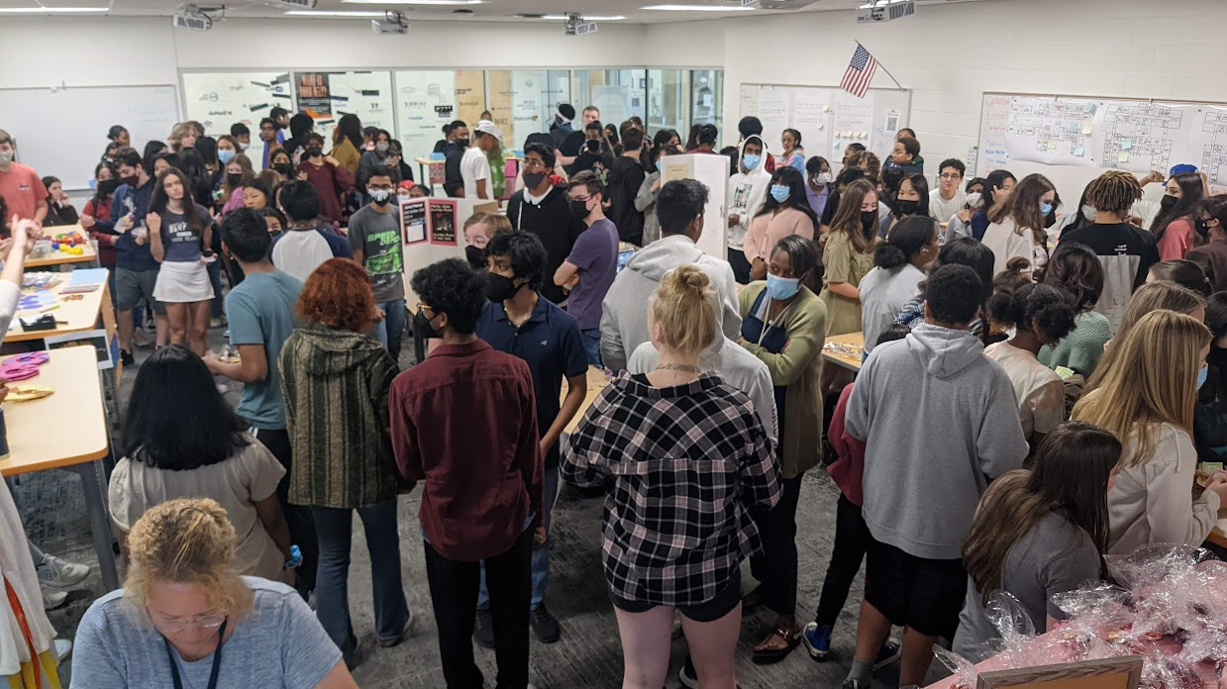
IA PTSO Update
Working hard, having fun, and learning.

Slide 2
Student Engagement

Slide 3
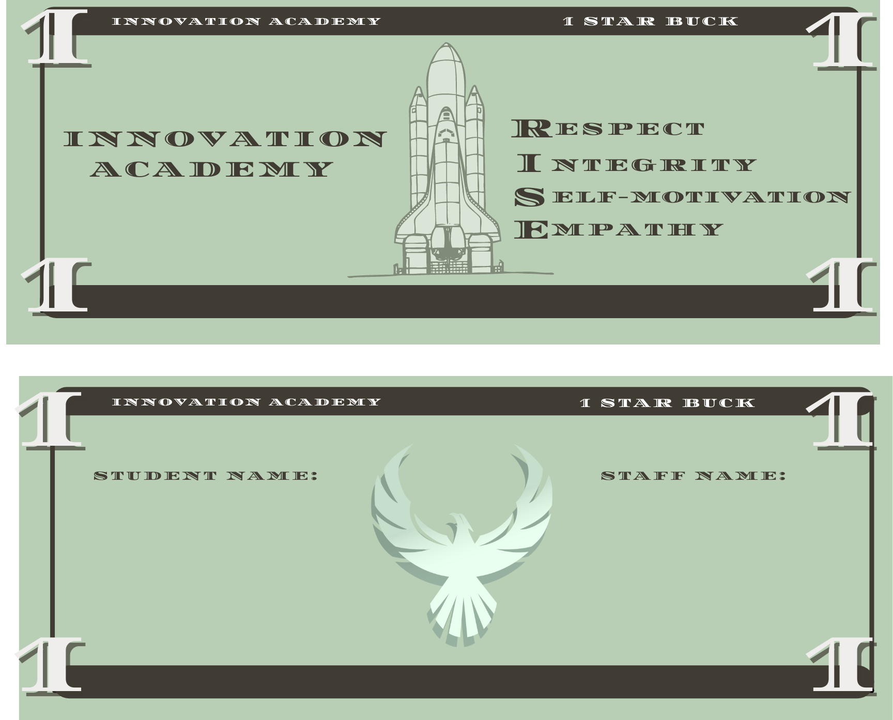
RISE: Respect Integrity Self-motivation Empathy
Recognize students and staff for representing RISE values (Star Bucks, RISE Shout Out).
Include students in decisions and implementation of what positive behavior looks like at IA.
Student-focus group and Parent-focus group (coming soon)

Slide 4
Club Fair
Over 60 student clubs created
They can meet before, during, or after school.
Extracurricular block day built in for all students to participate
Rich and deep engagement over superficial activities

Slide 5
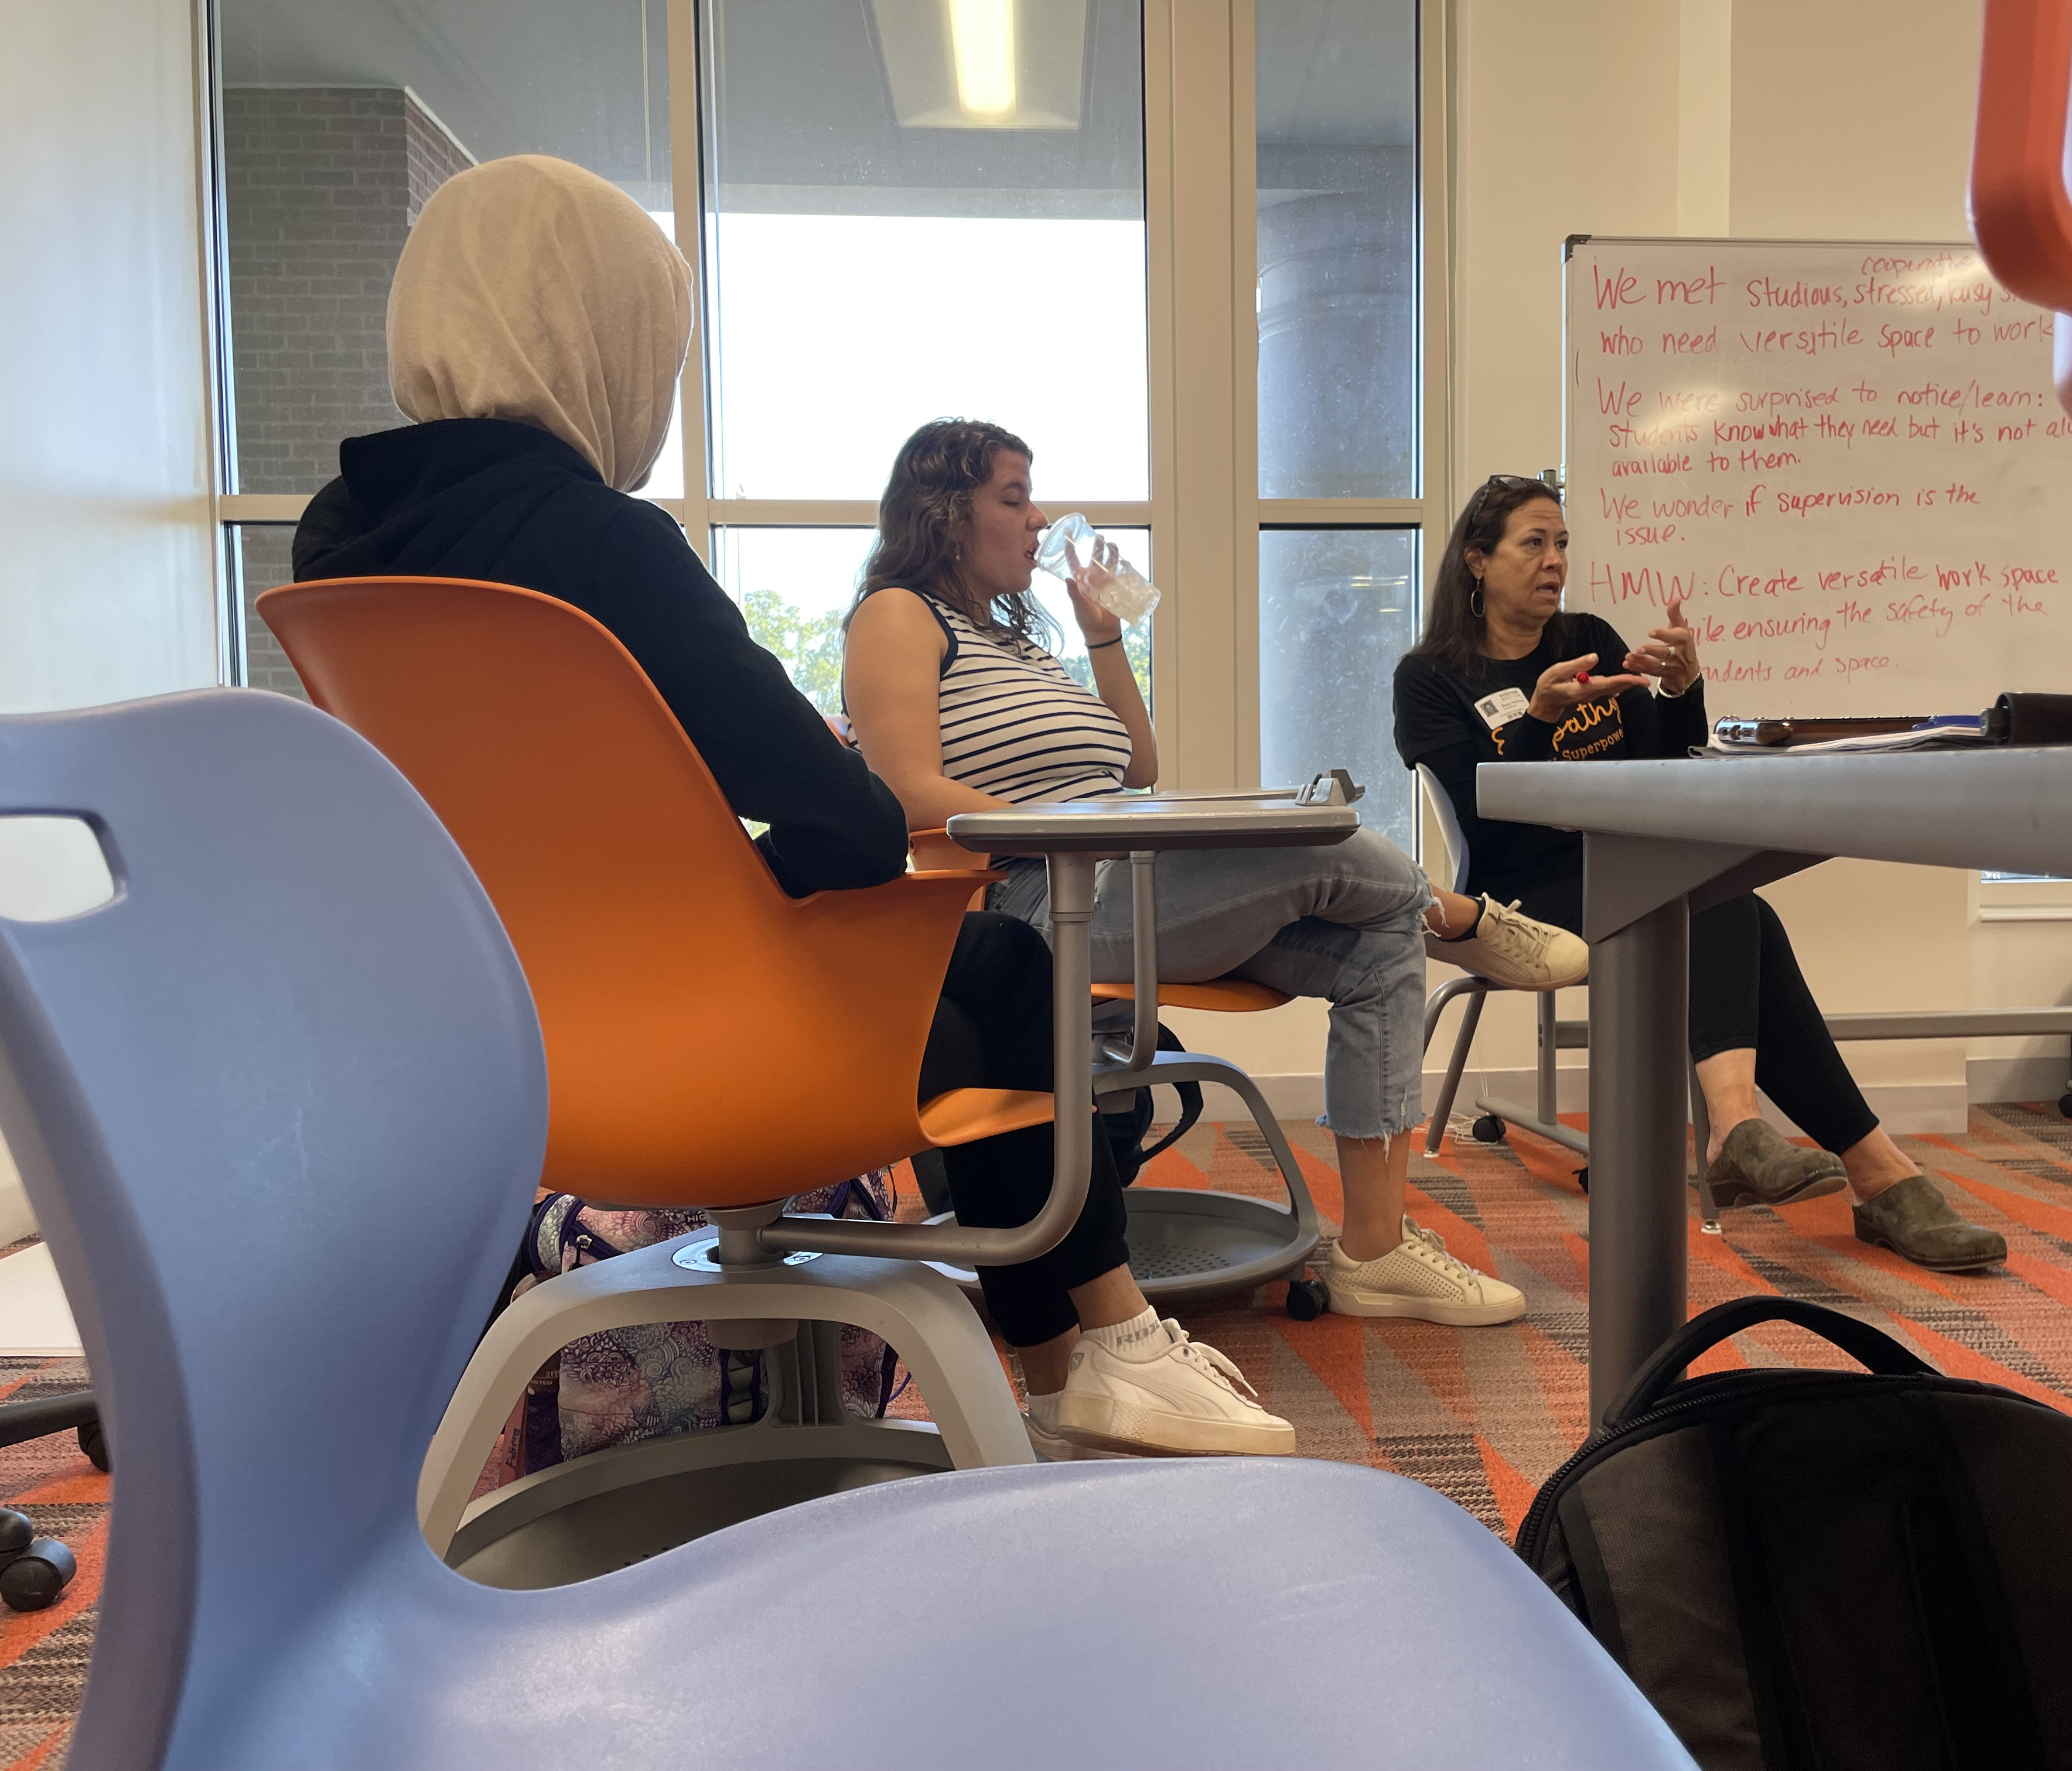
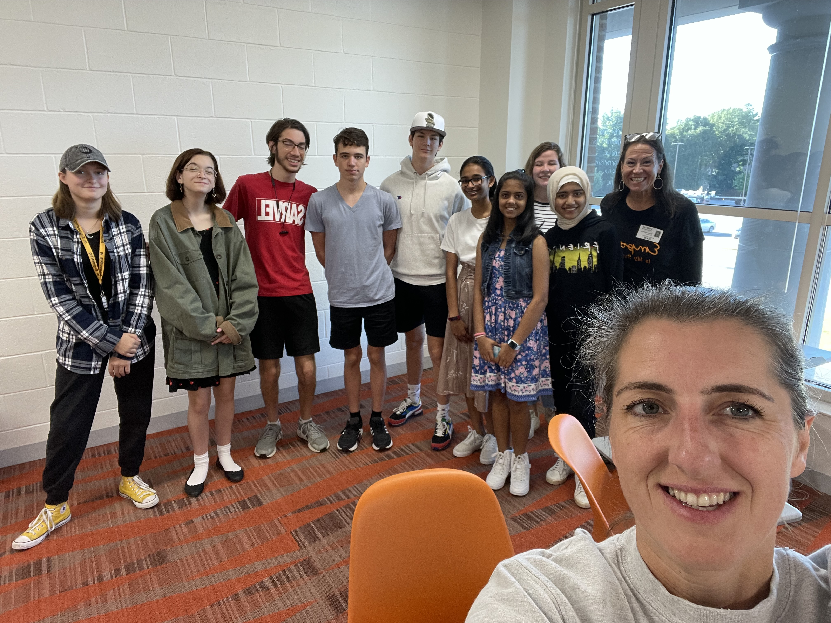
Student Design Thinking Team
Goals for the year:
-Design and prototype a workspace for students
-Design the IA DT Studio
-Network with designers and creative thinkers
-Build leadership capacity to train students '23-'24

Slide 6
Moonshot 10th / 11th
Students will have the opportunity to participate on December 9th
Sign up information will be shared with students in Teams

Slide 7
Career Pathways

Slide 8
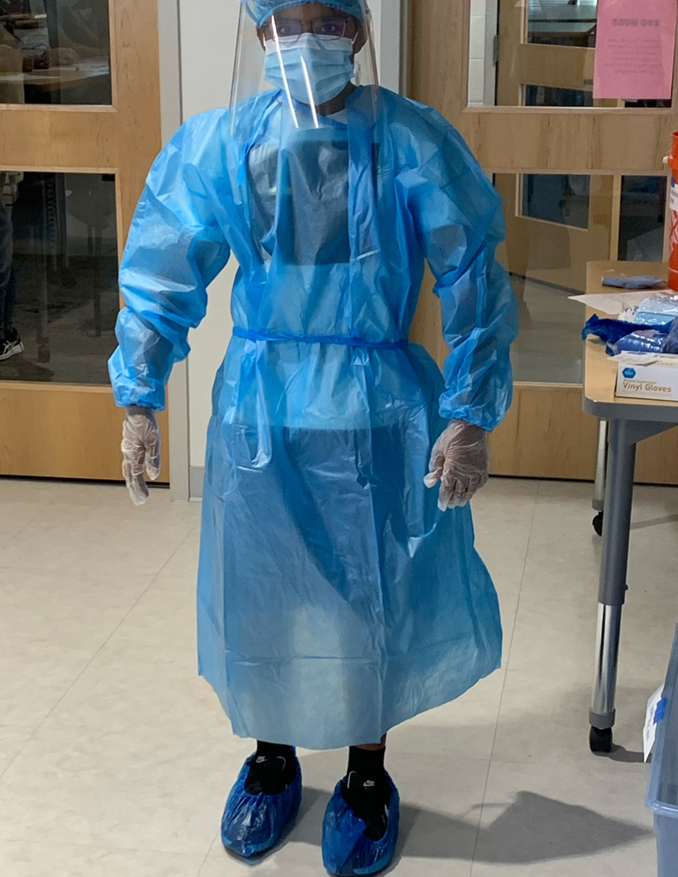
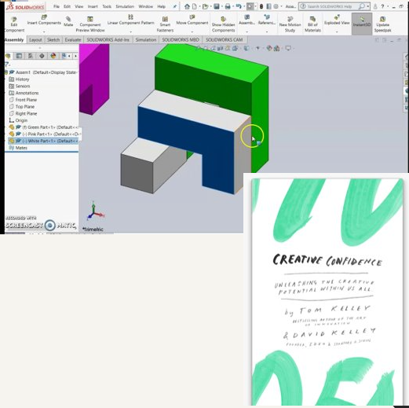
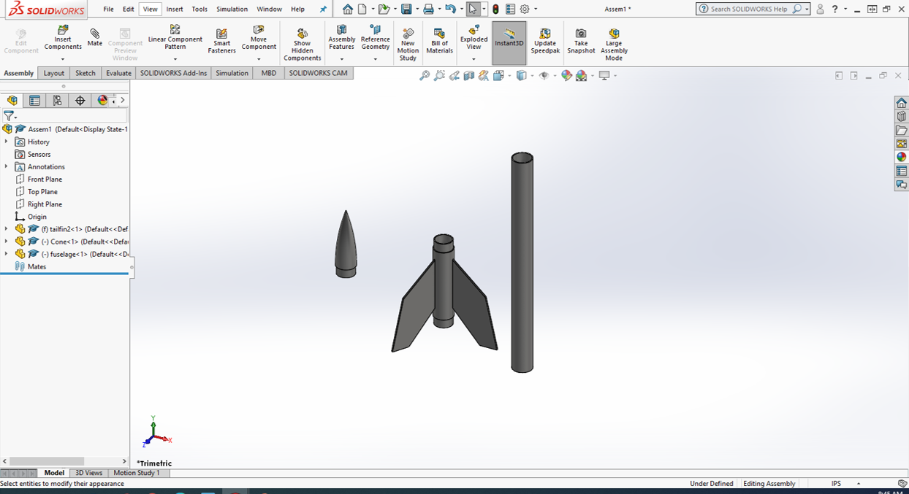
Engineering
GT Block – Redesigning PPE
Engineering Concepts – Multi-part assemblies and animation using CAD
Engineering Applications – reading "Creative Confidence" and learning from other scenarios with difficult parameters
Upcoming events:
Oct 28th – Emphasis on Aerospace Engineering. "October Sky" with TED talk from GT rocket club

Slide 9
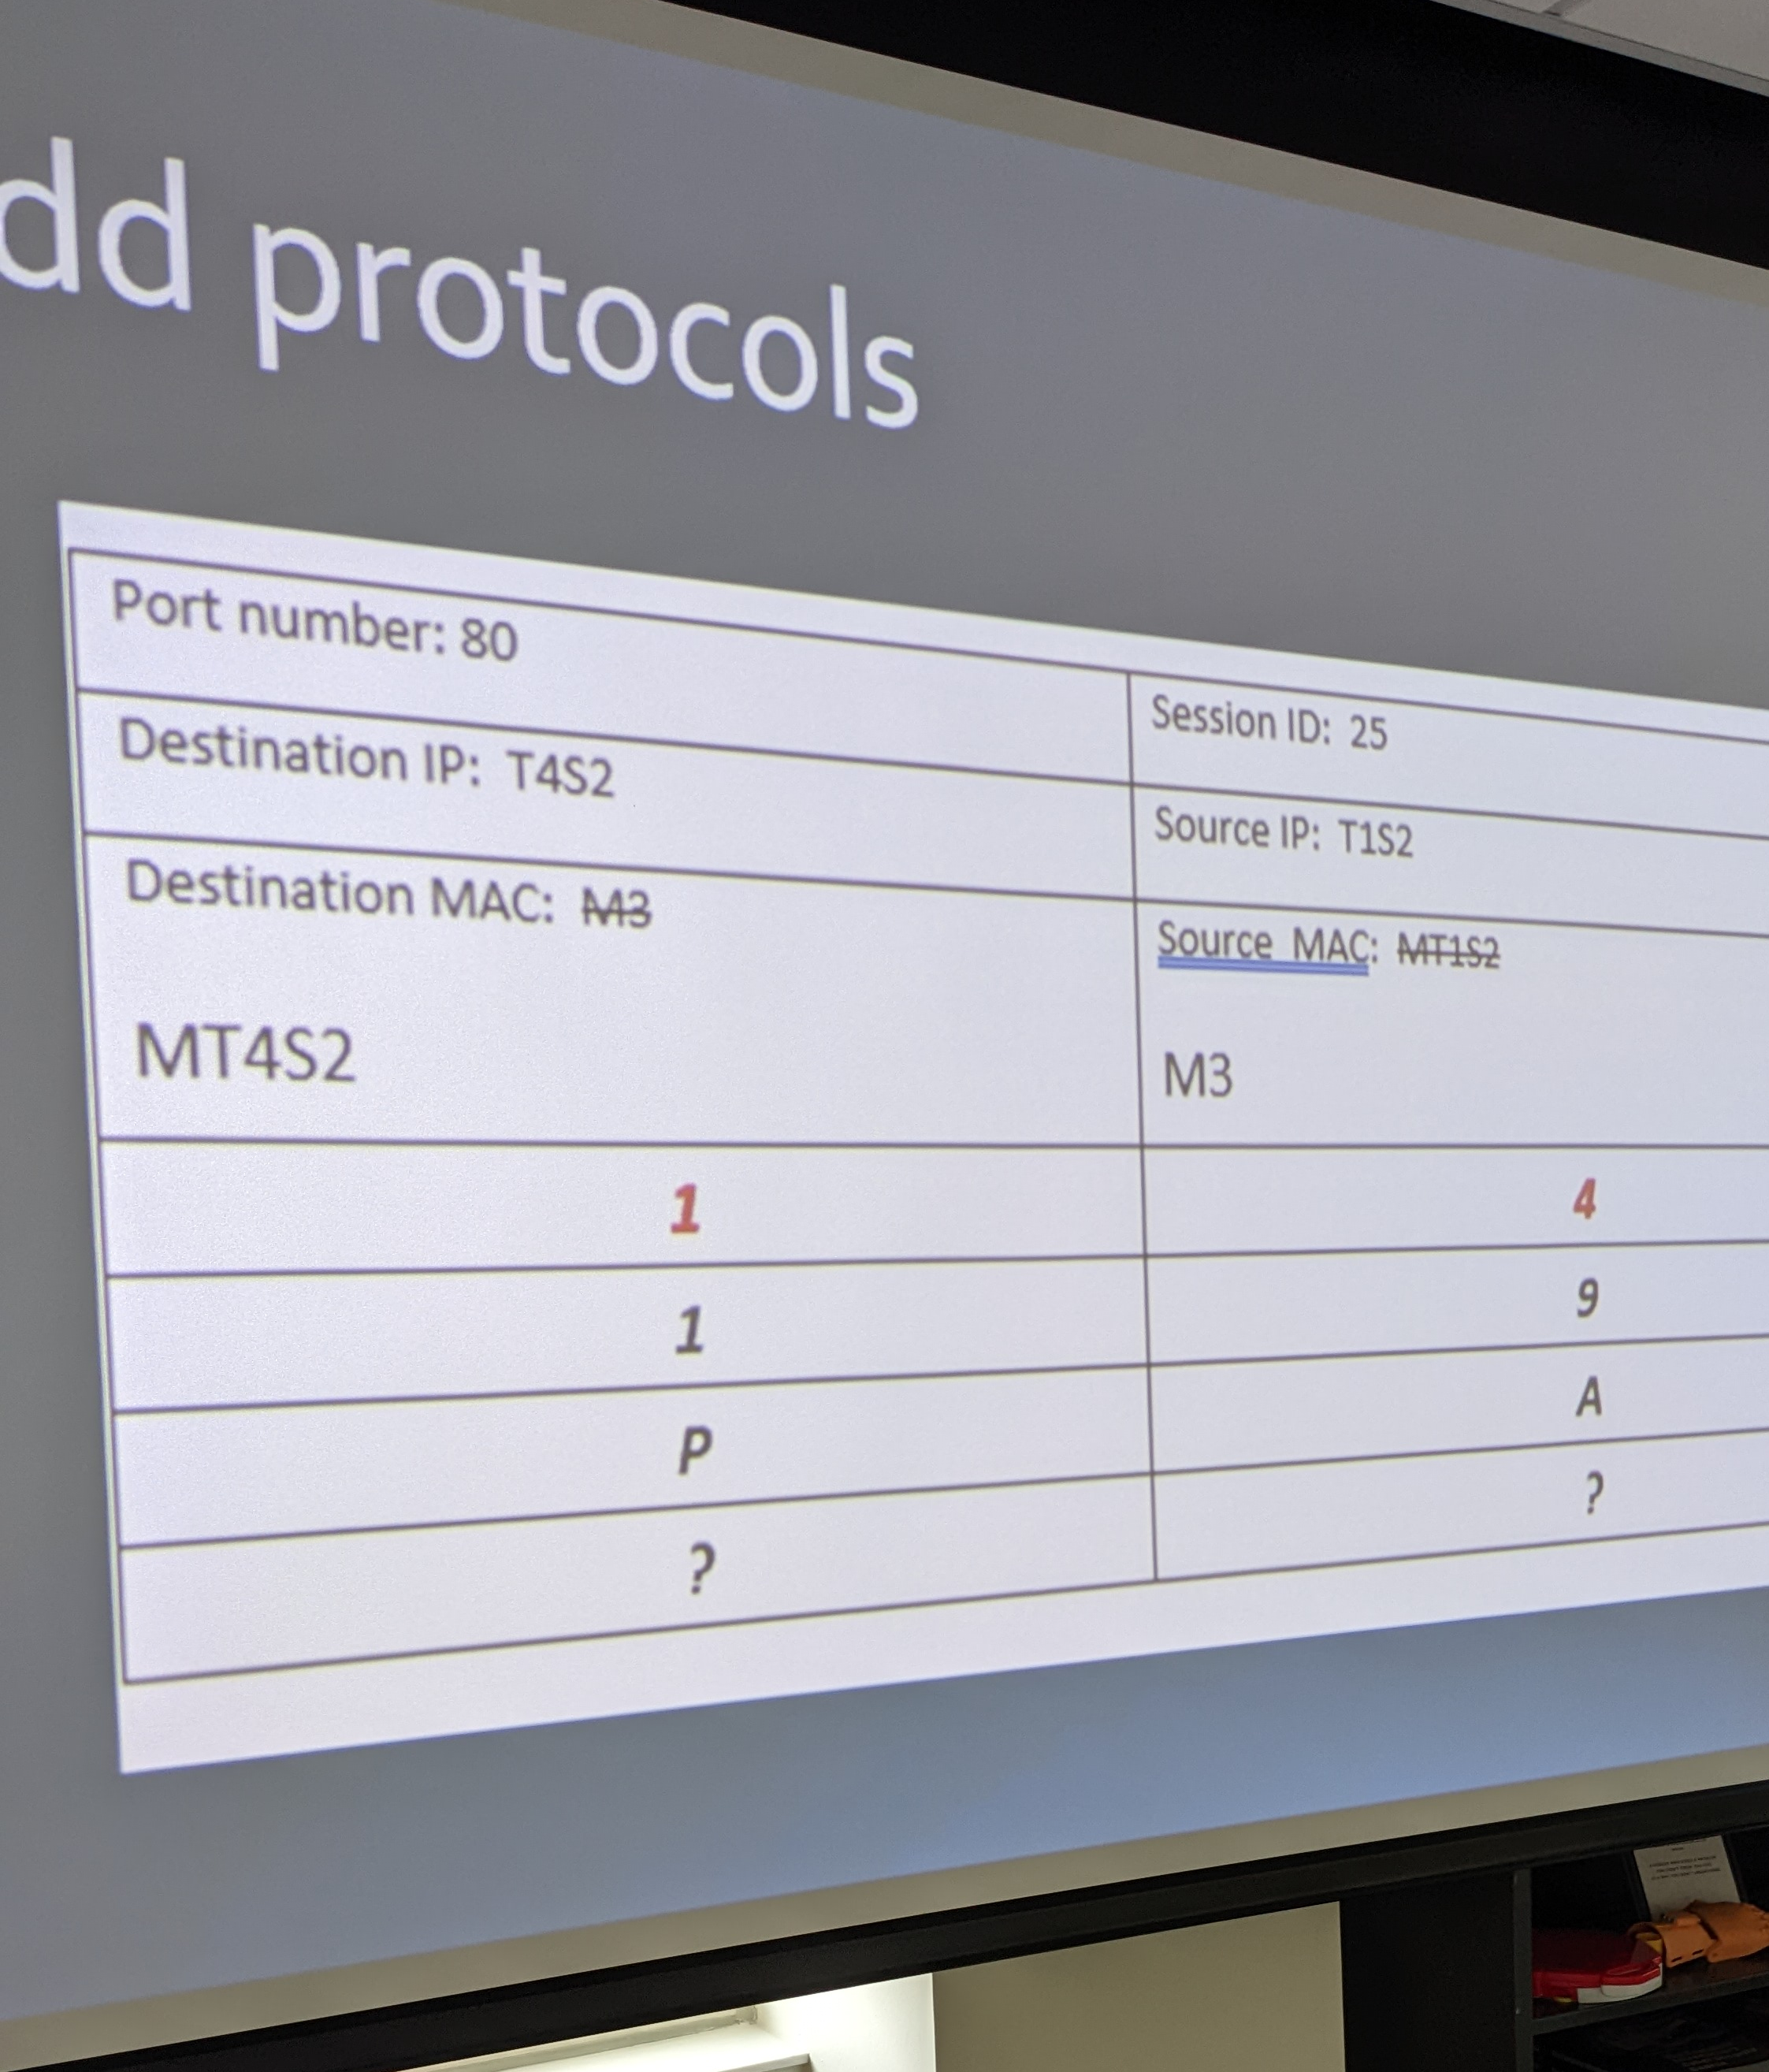
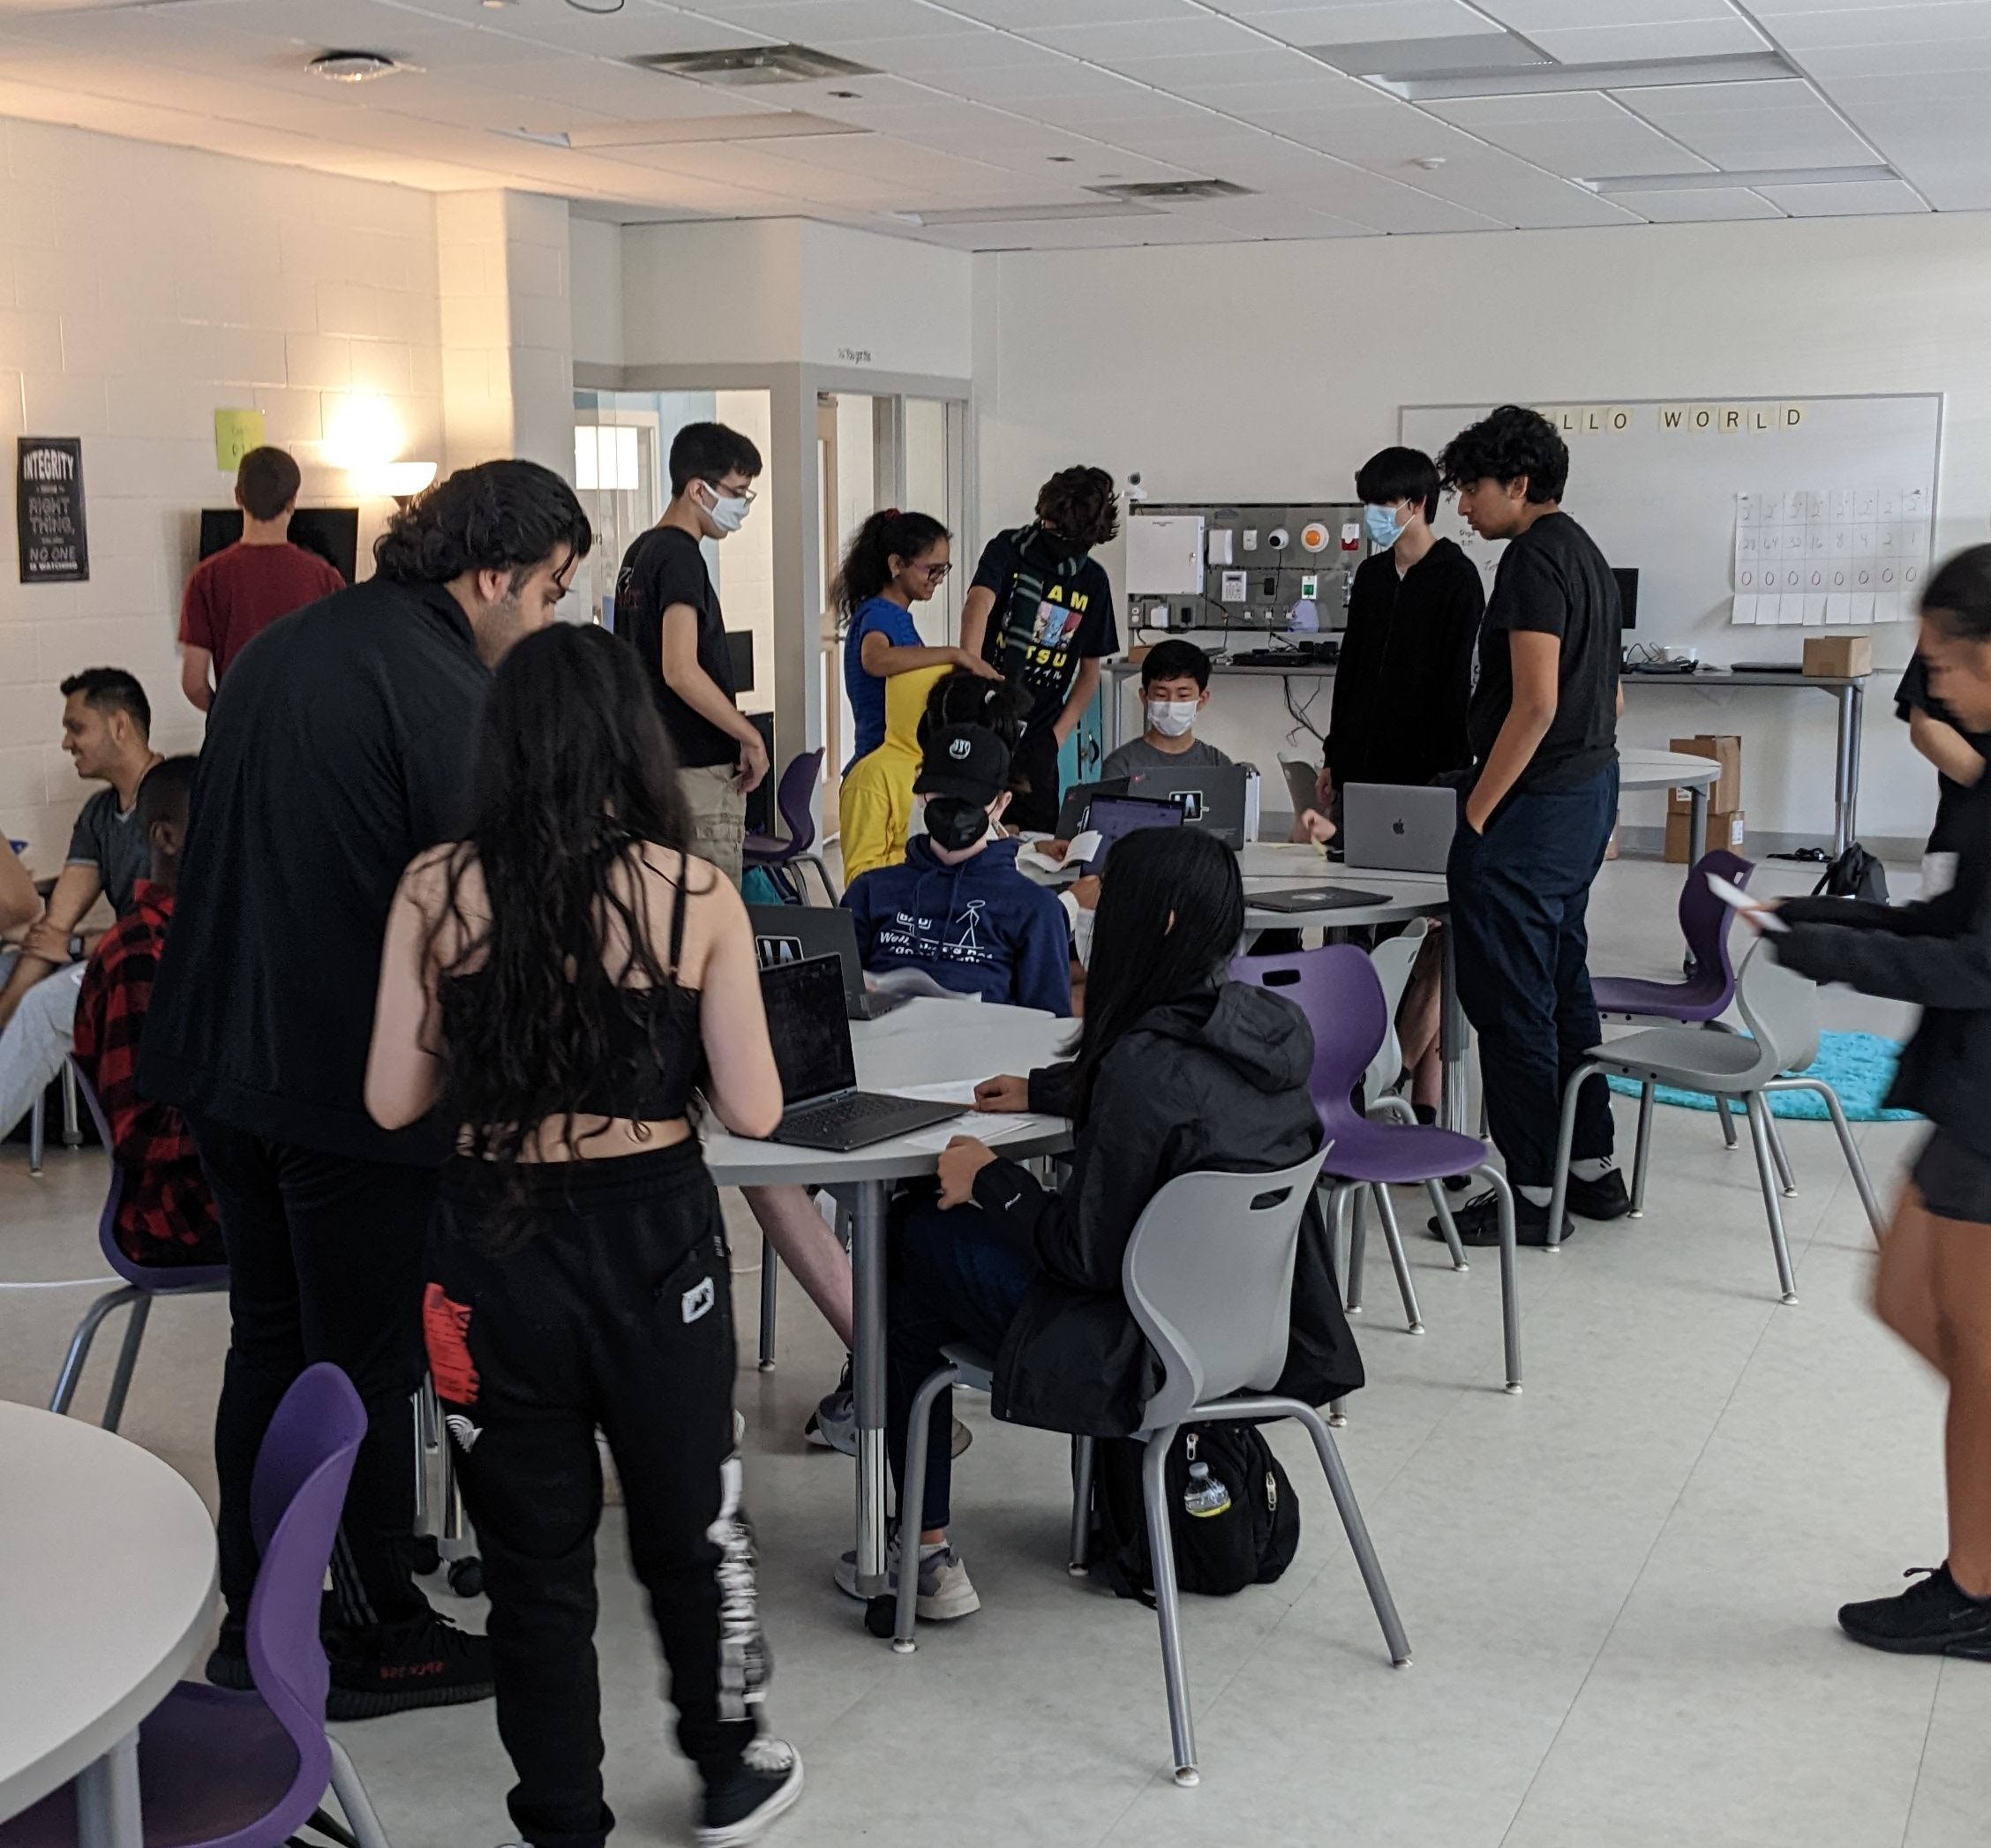
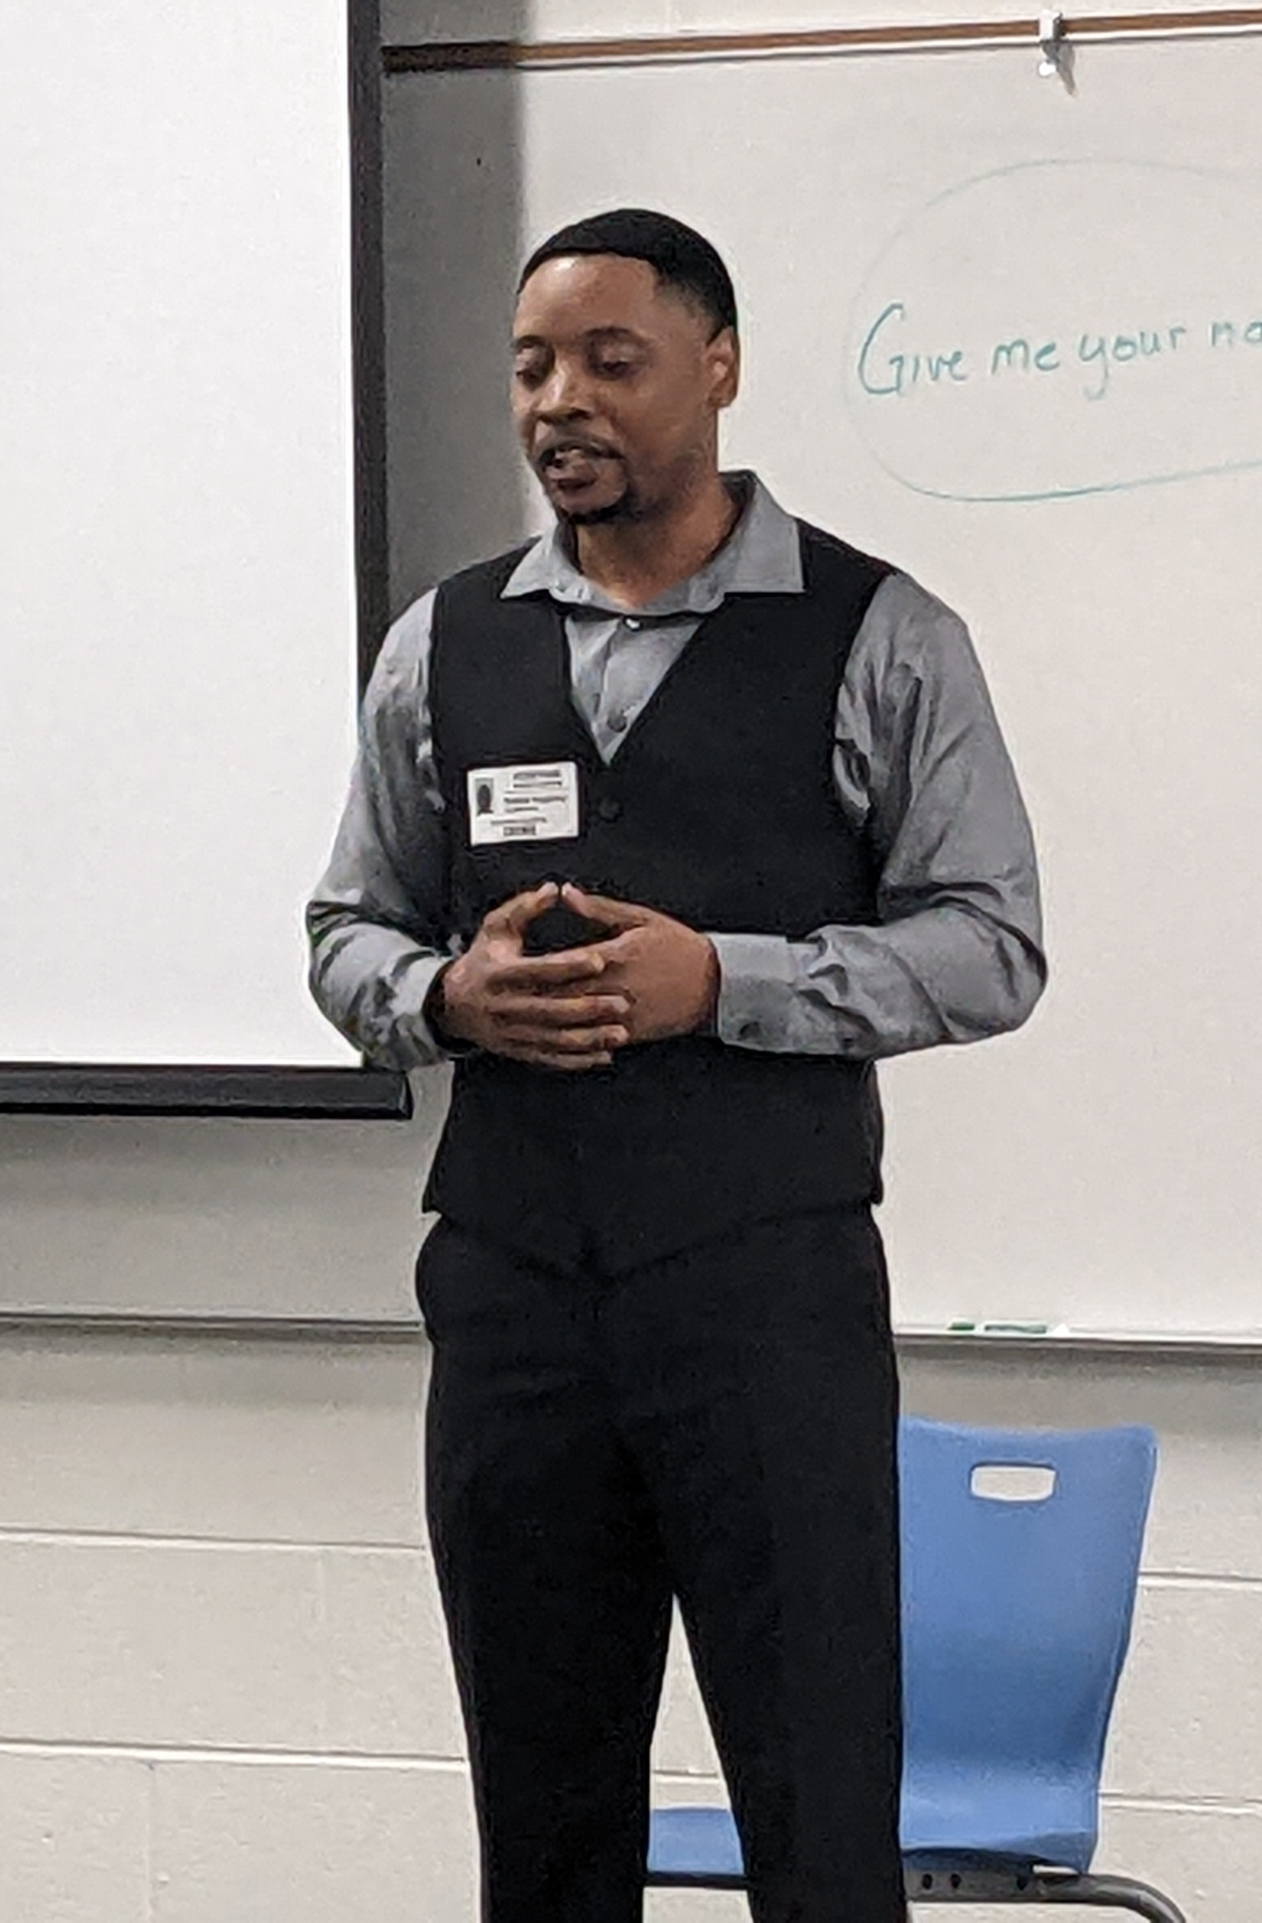
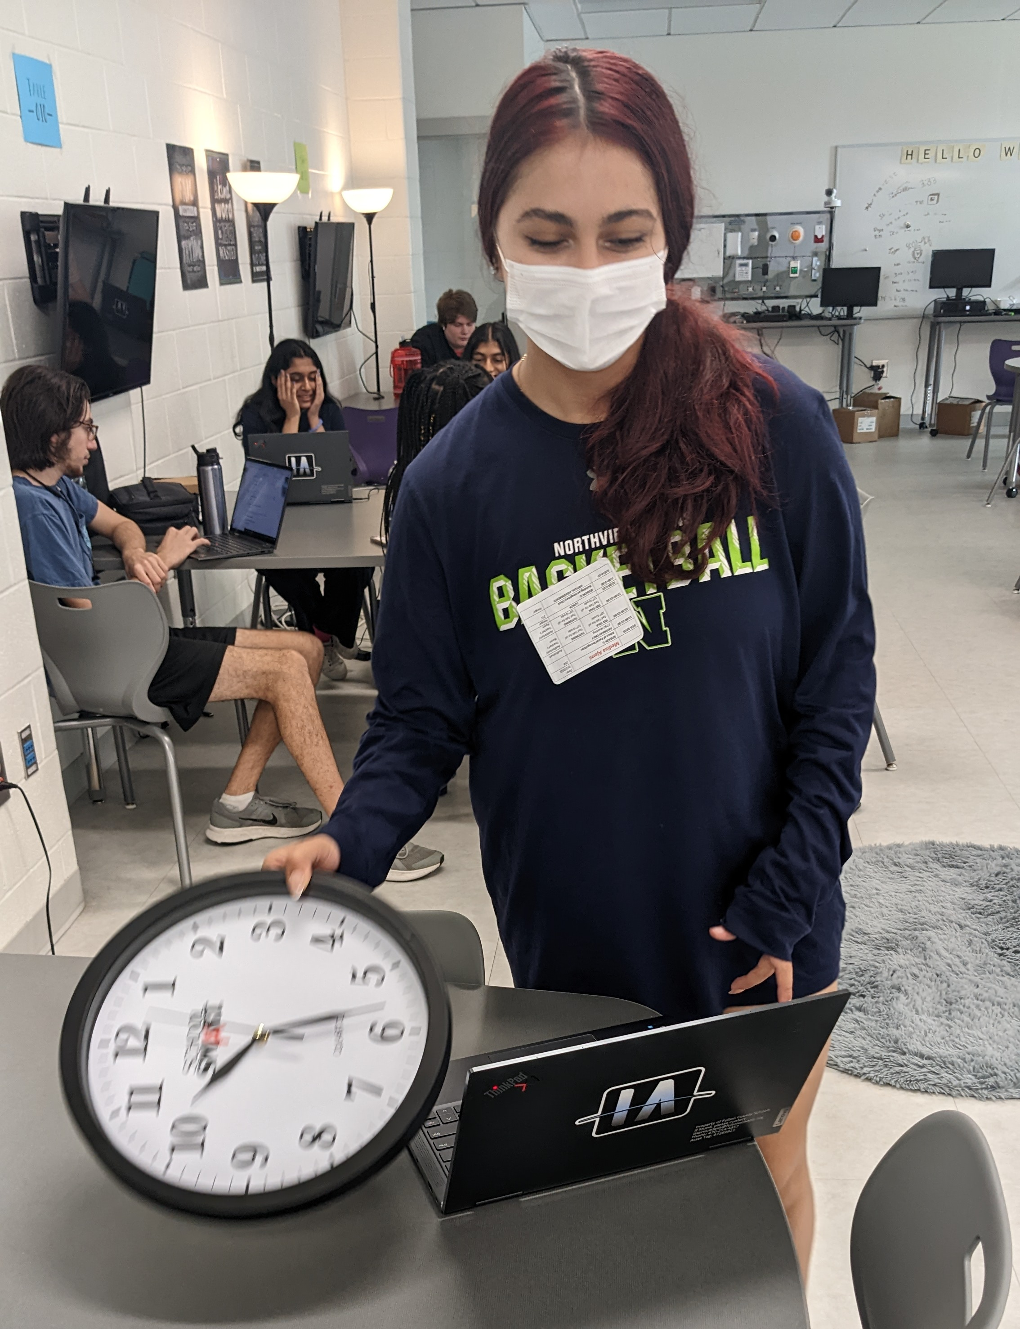
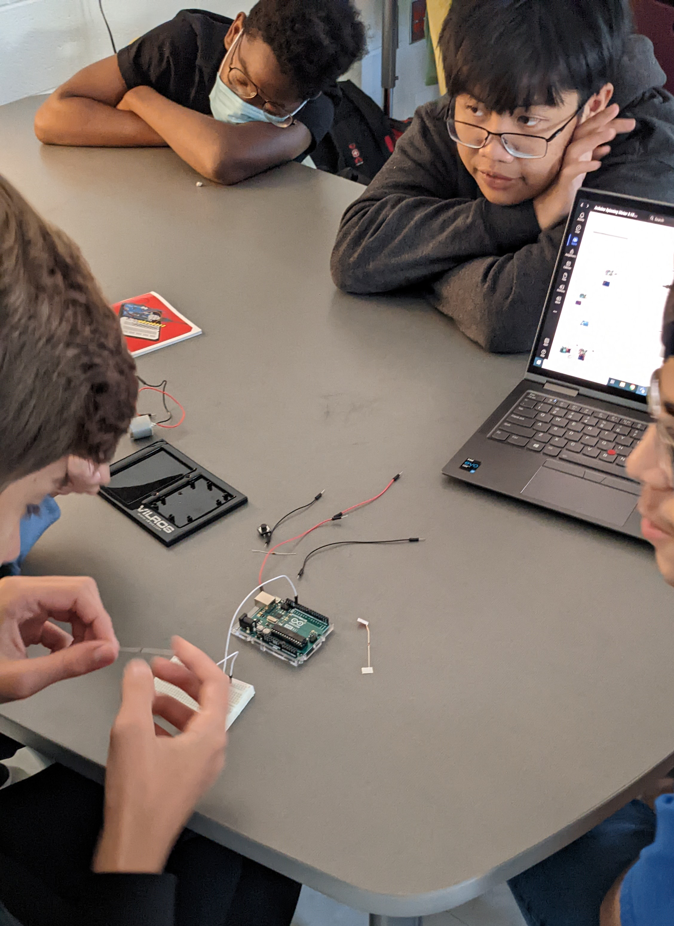
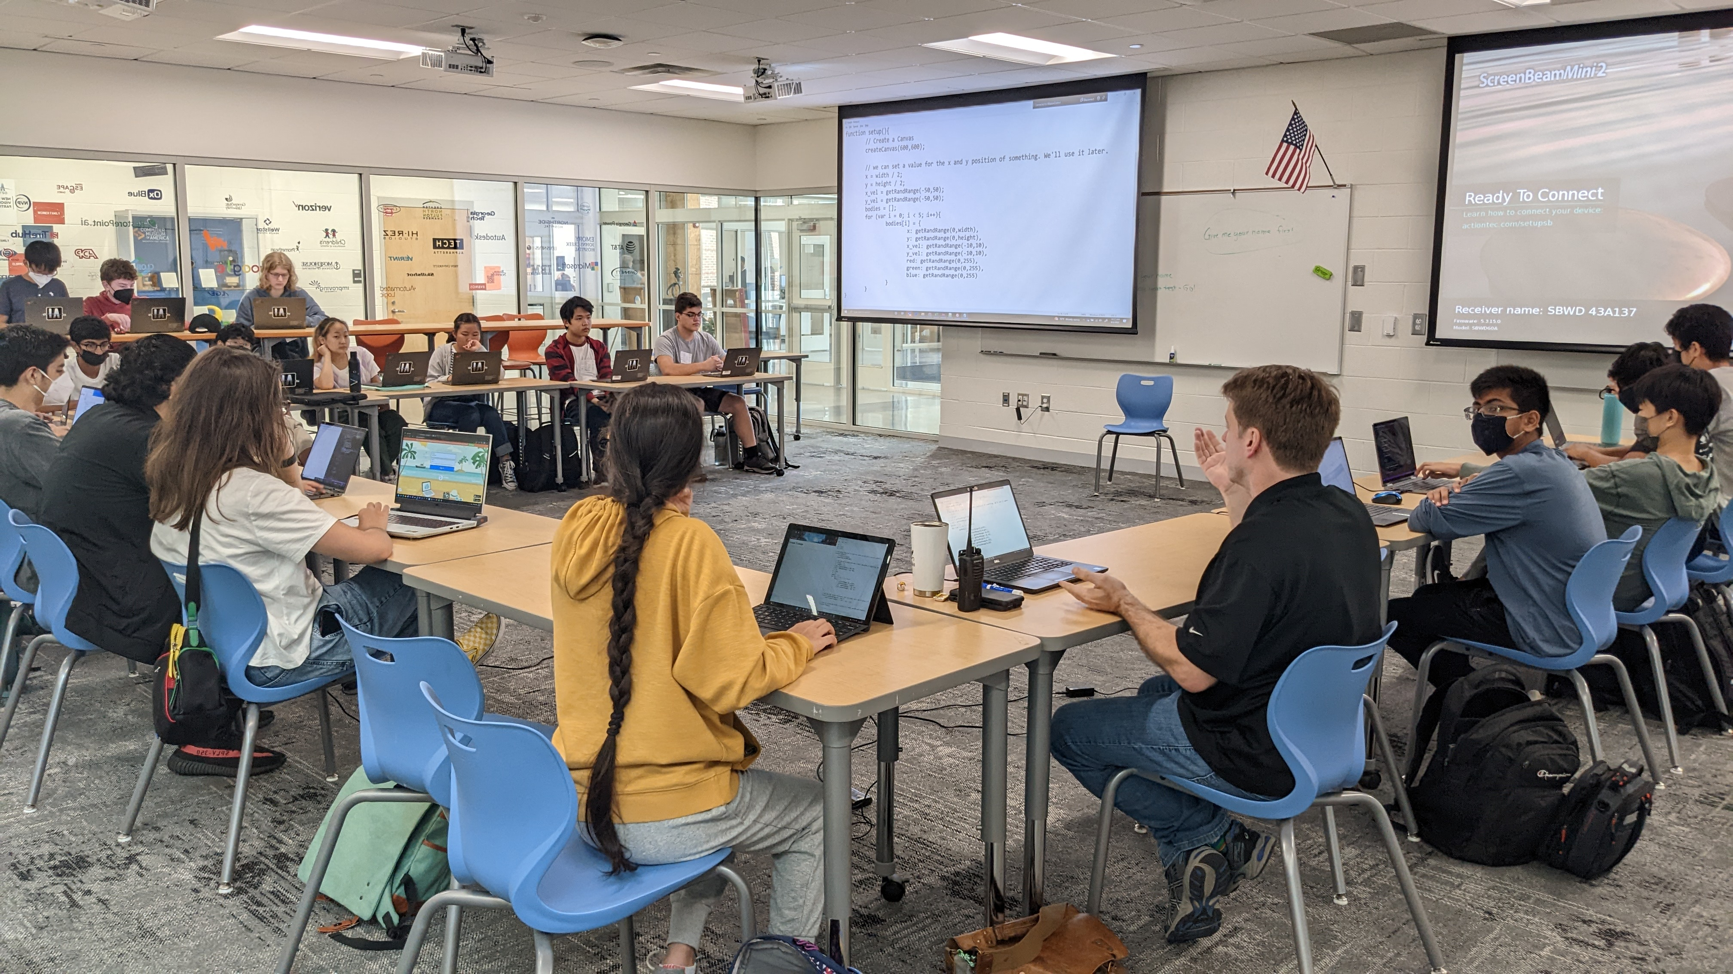
Information Technology
Classes include Intro to Digital Tech (GT Block), AP Computer Science Principles, Cybersecurity, Game Design and AP Computer Science A.
Upcoming Events: Social Engineering with Cox Enterprises, Beta Testing with Zilla and Info Clock iteration with founder, Jeff Fischer.
Upcoming Collaboration: World History & APCSP combine to create adventure games based on historically accurate trade routes.
Cyber classes demo OSI & MAC addressing
Guest Speaker:
Rafael Hughley, retired Air Force Cybersecurity
IT Friday creating AI training sets
IT Friday coding exploration!
GT Block & Arduino programming

Slide 10
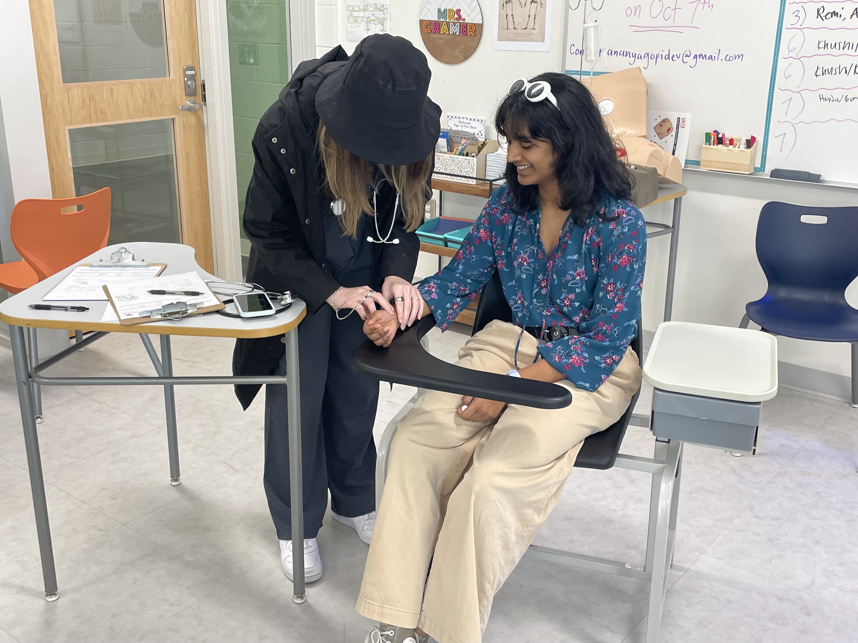
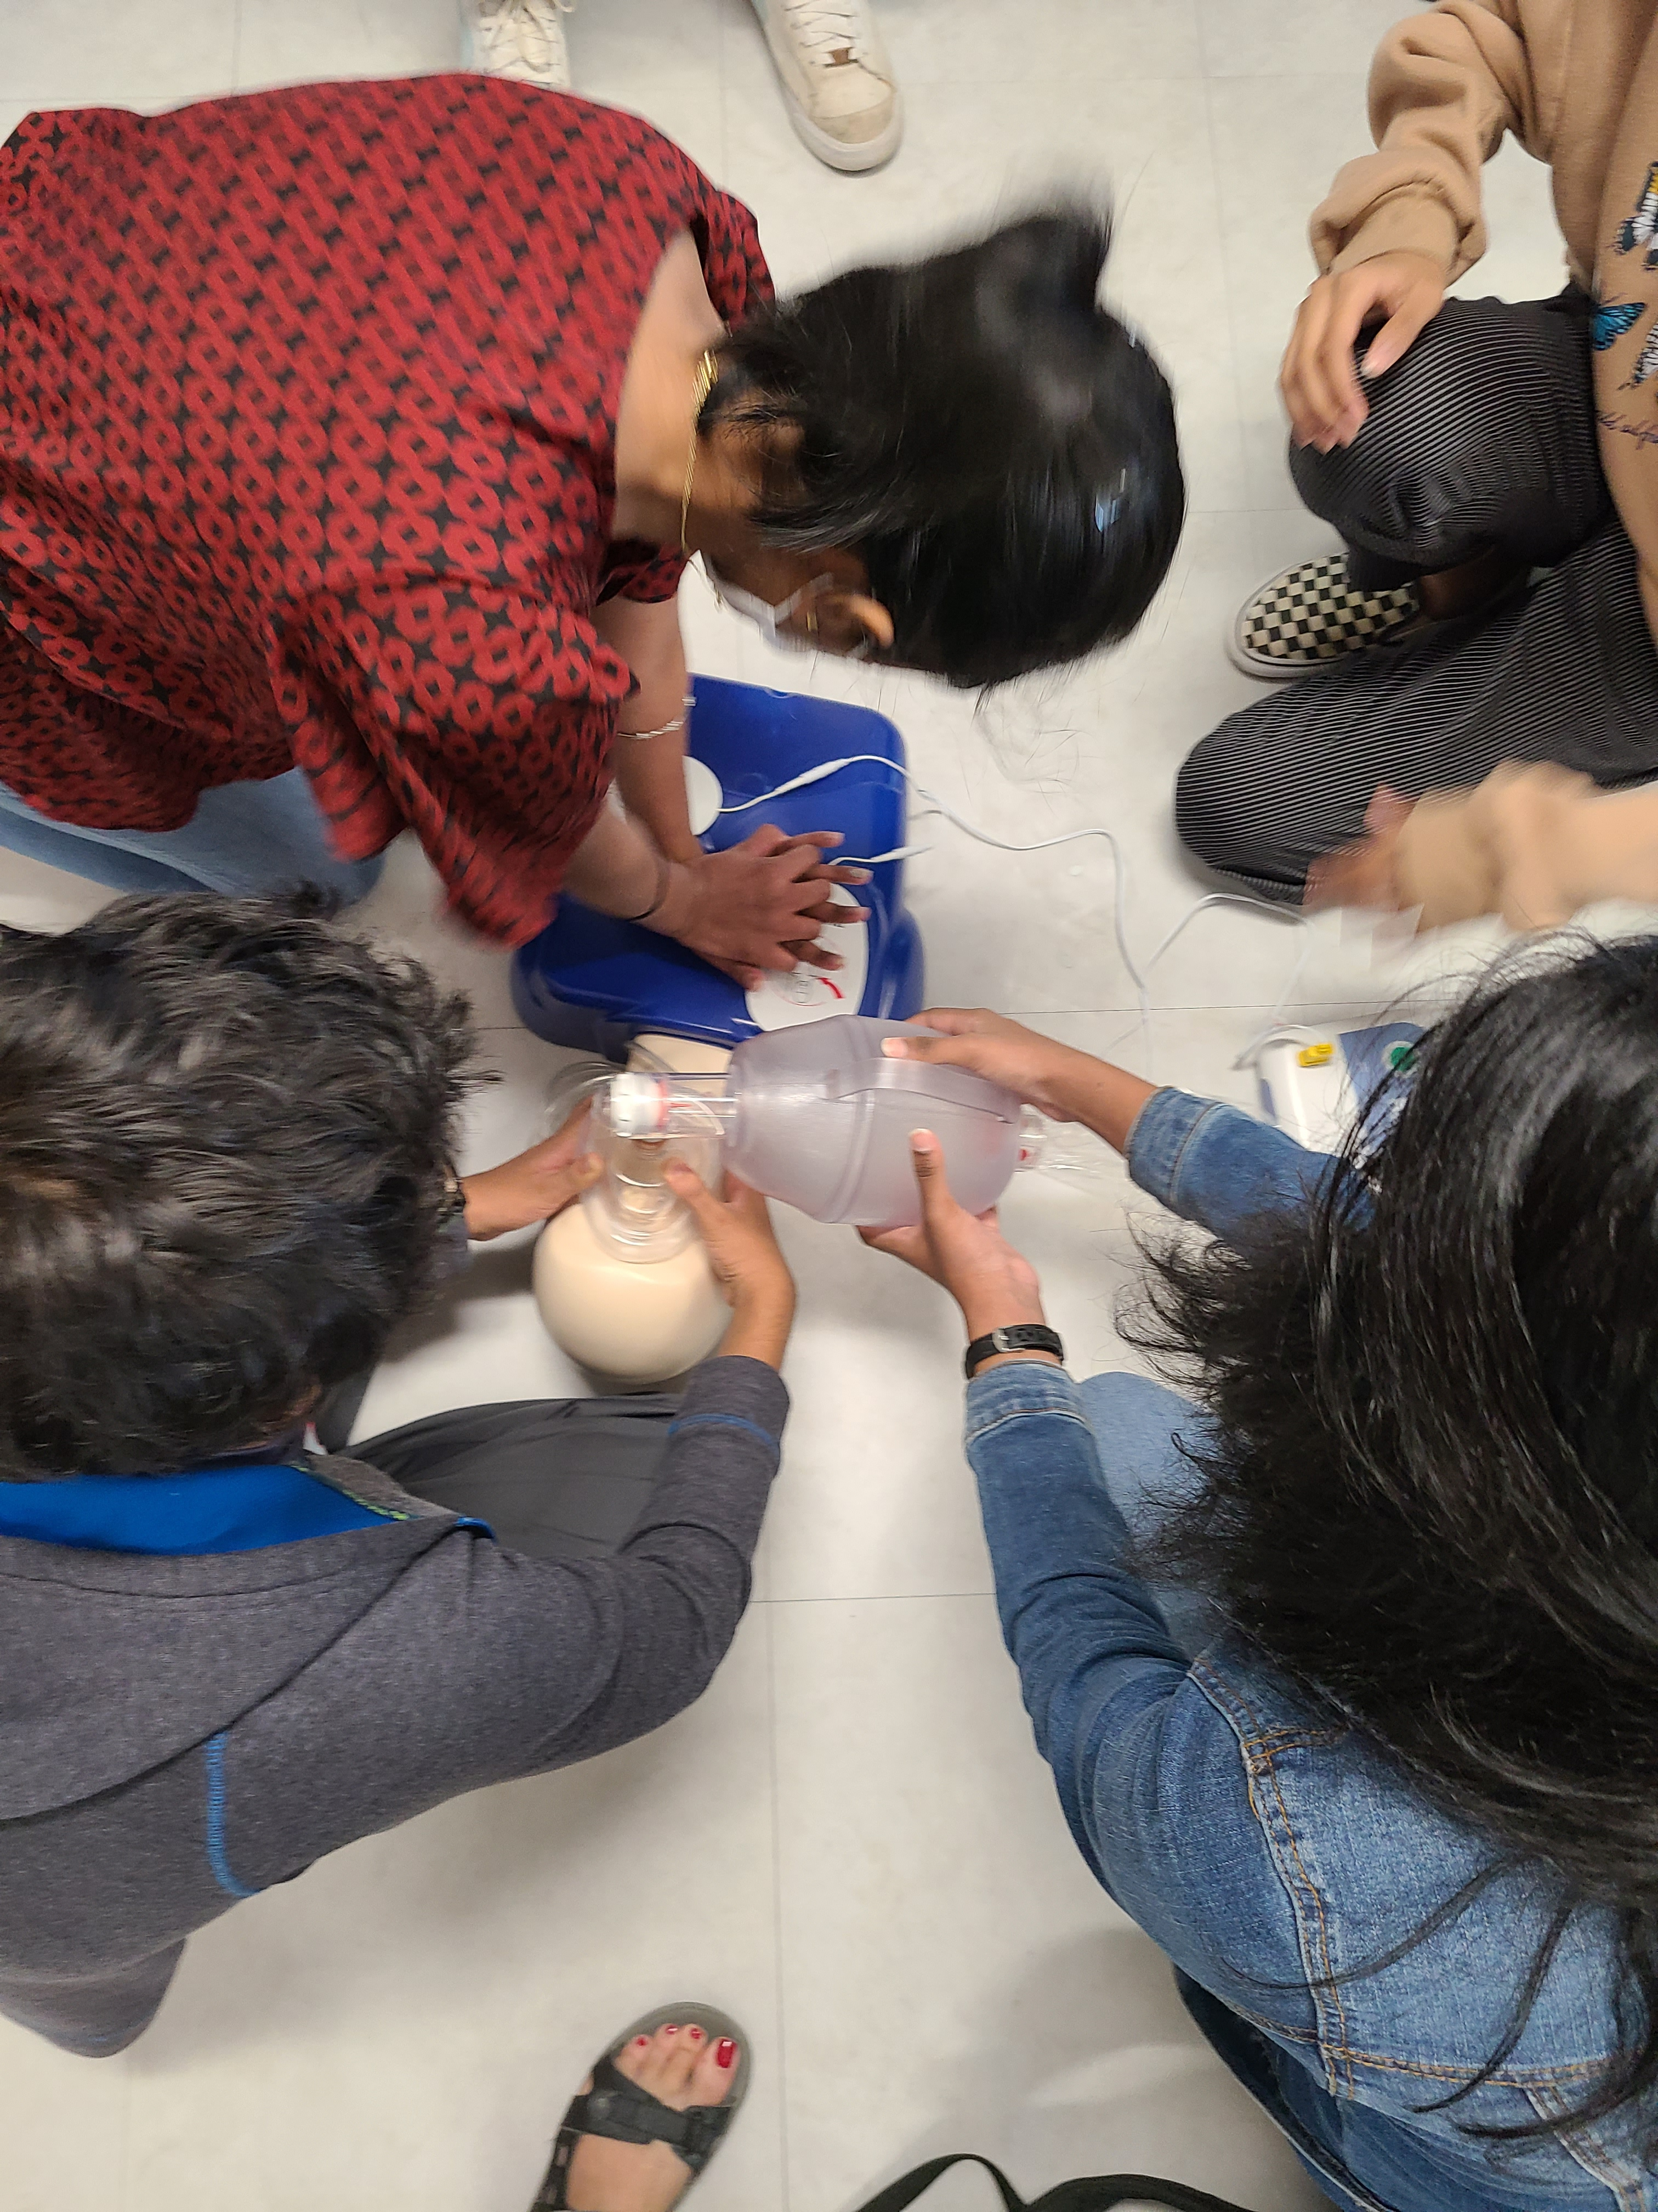
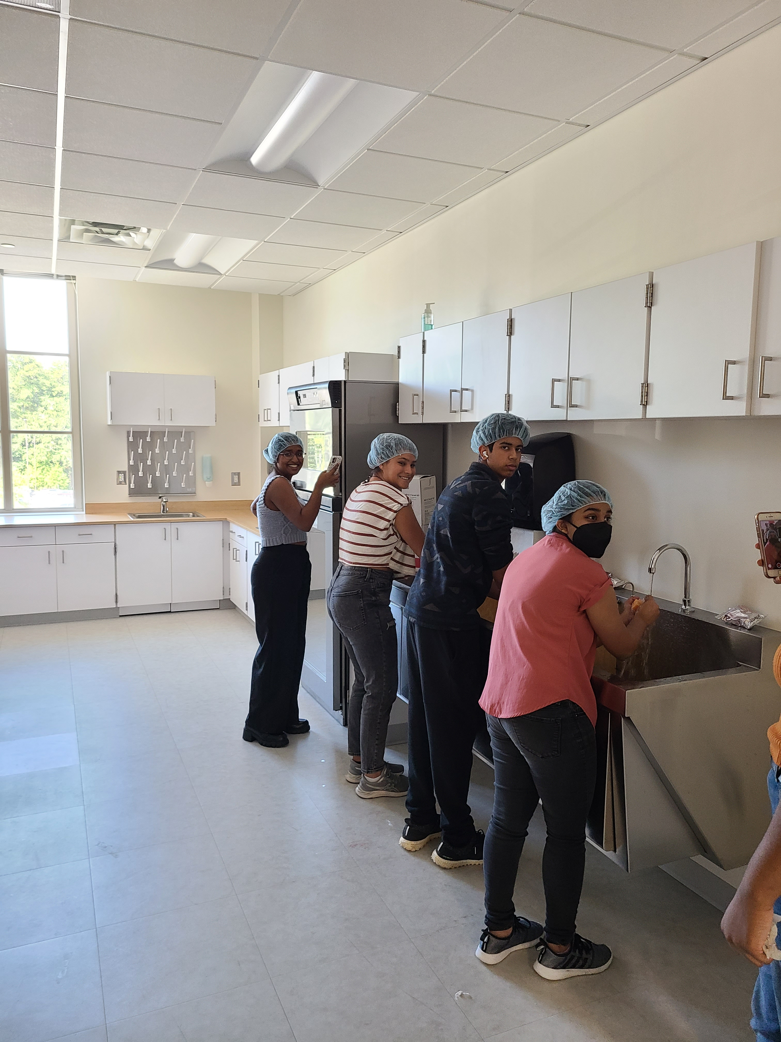
Health Science

Slide 11
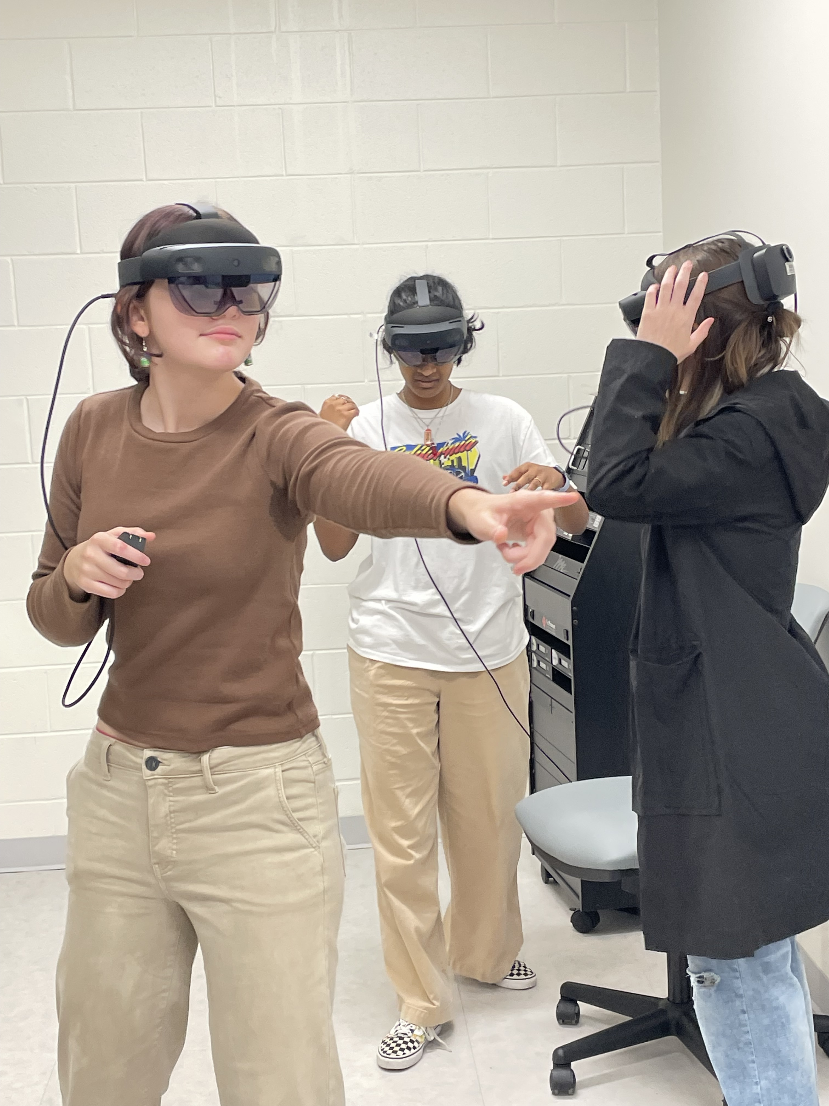
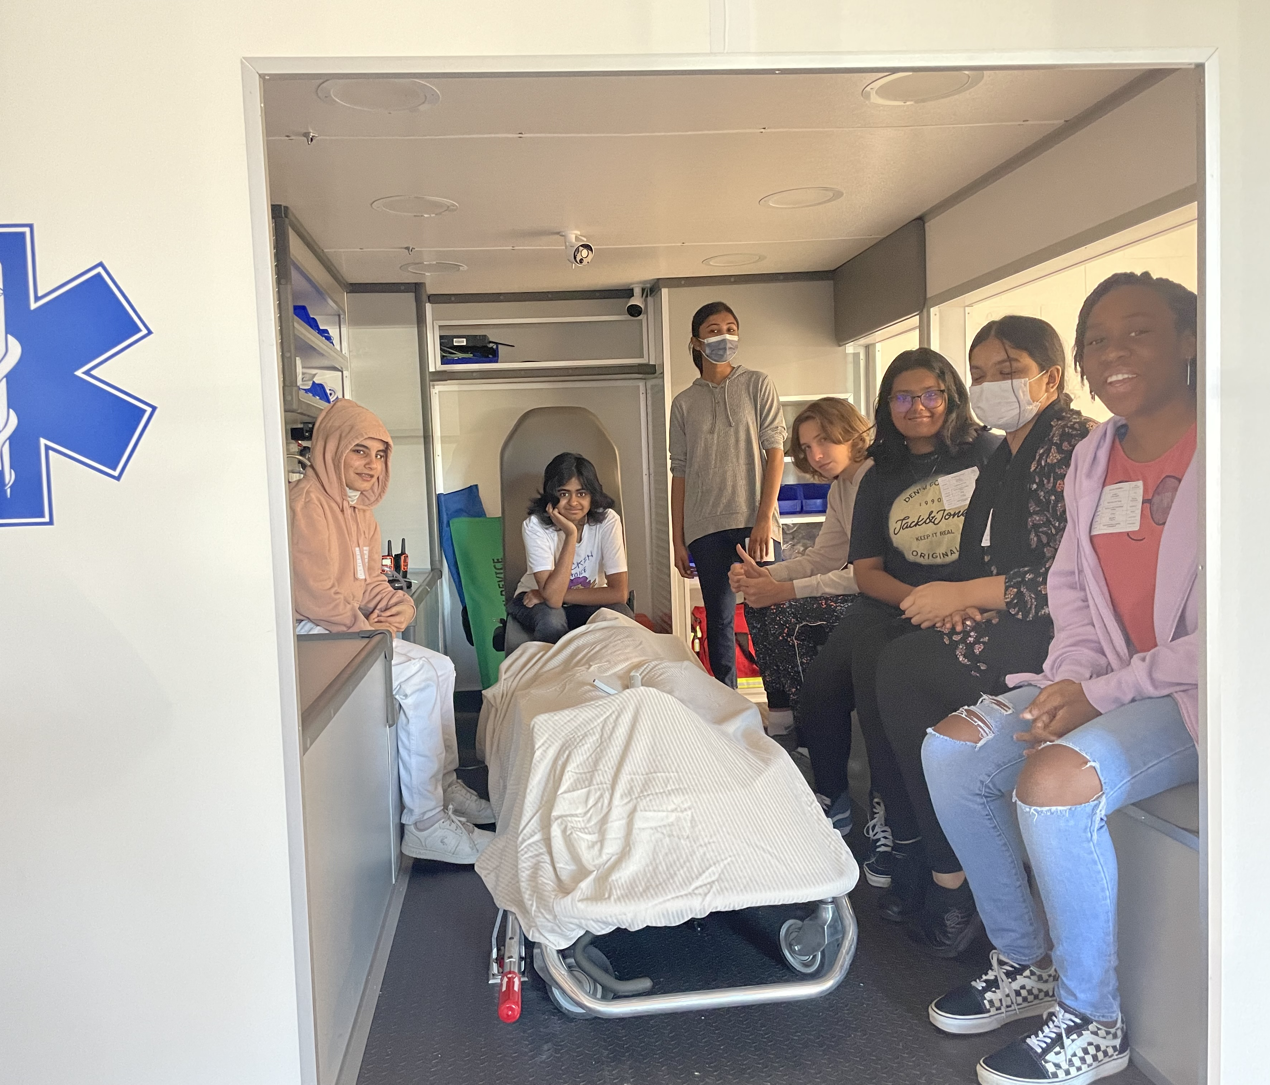
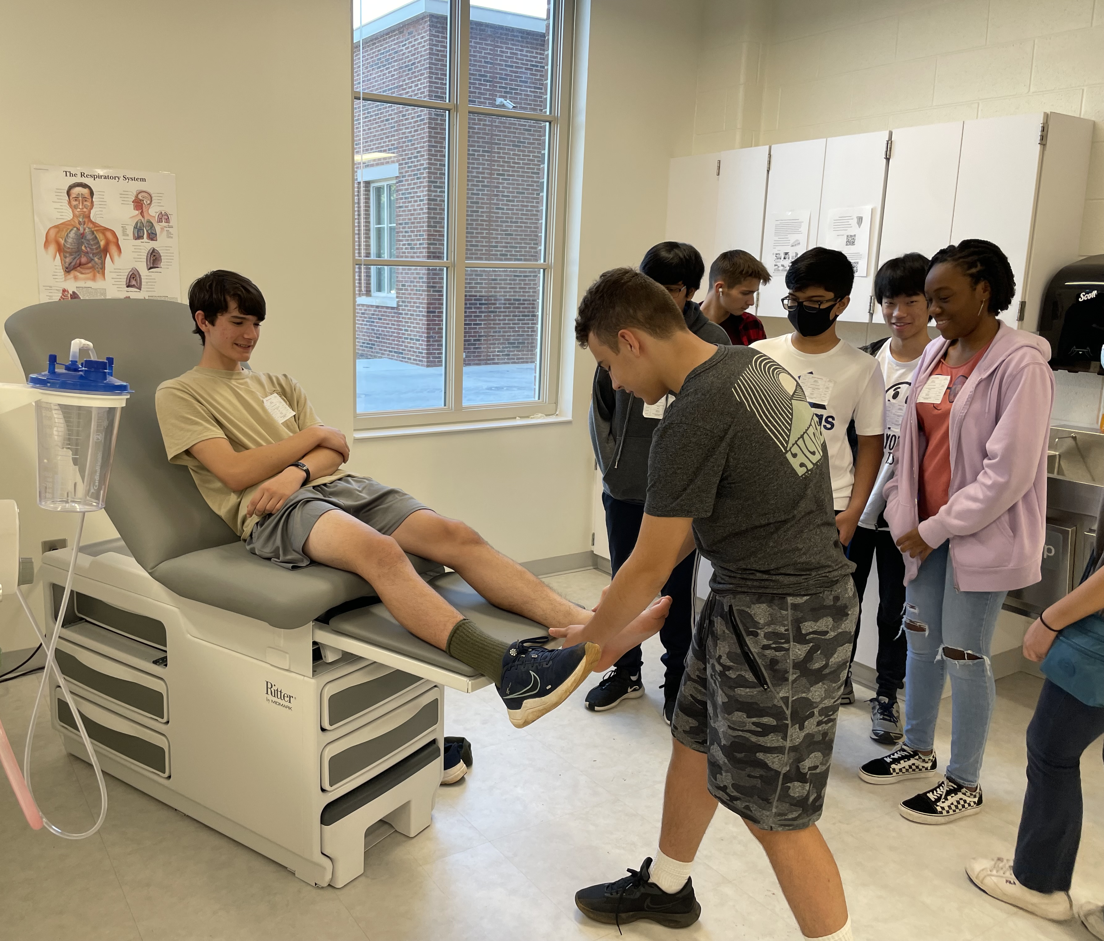
Health Science Labs & Simulation
Students spend time applying classroom learning in practical applications

Slide 12
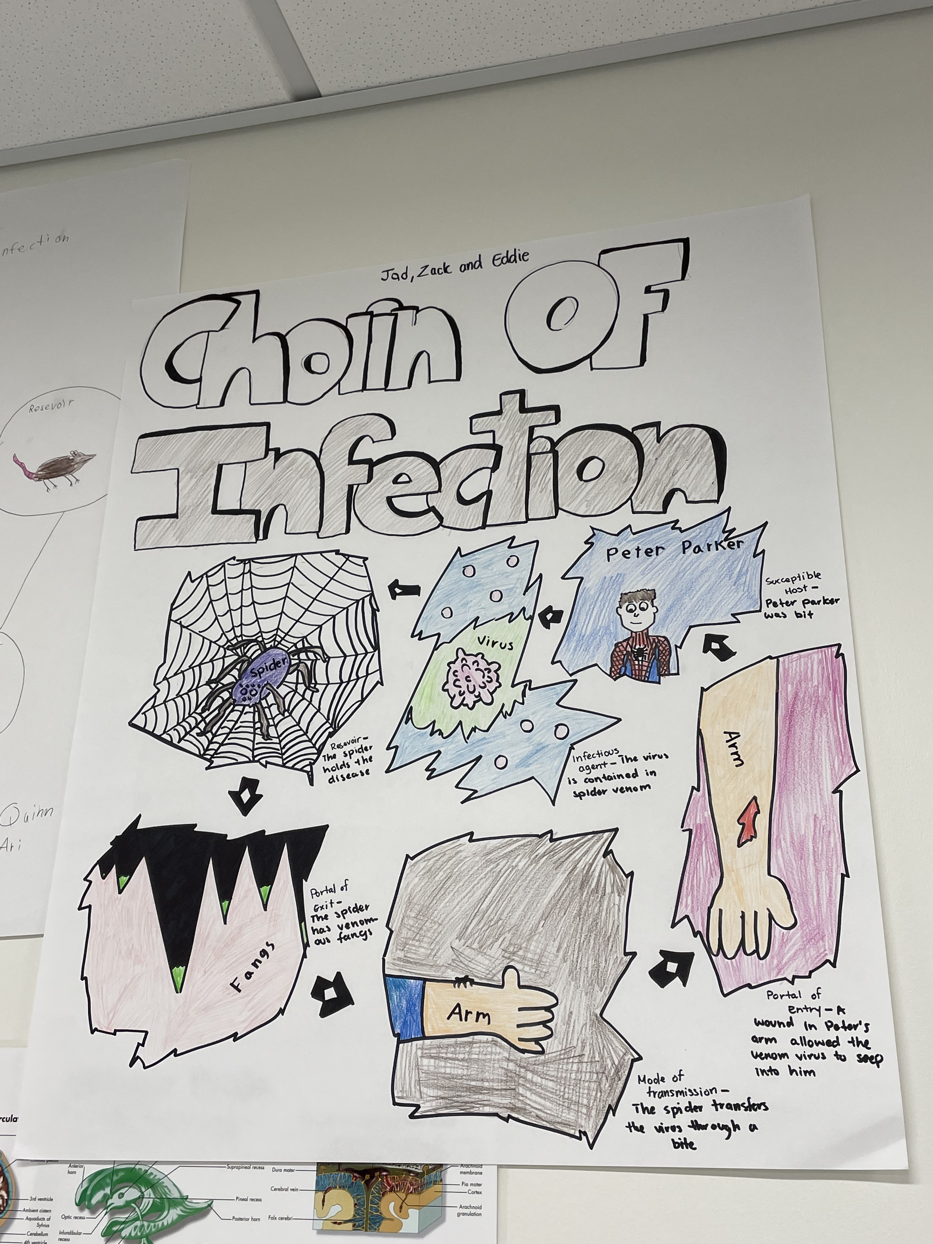
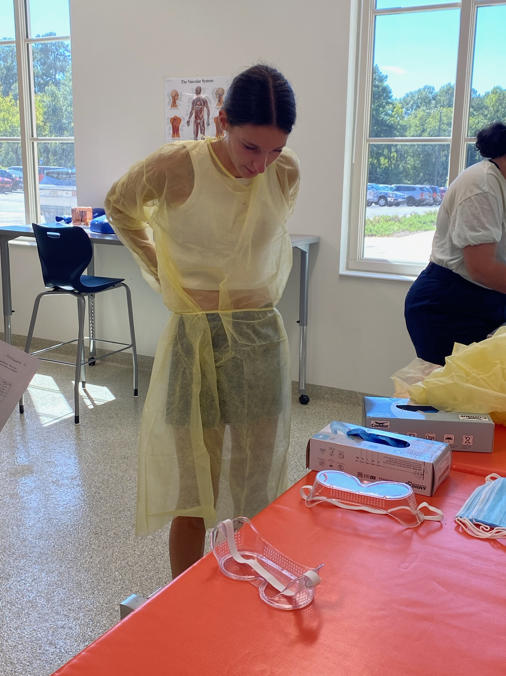
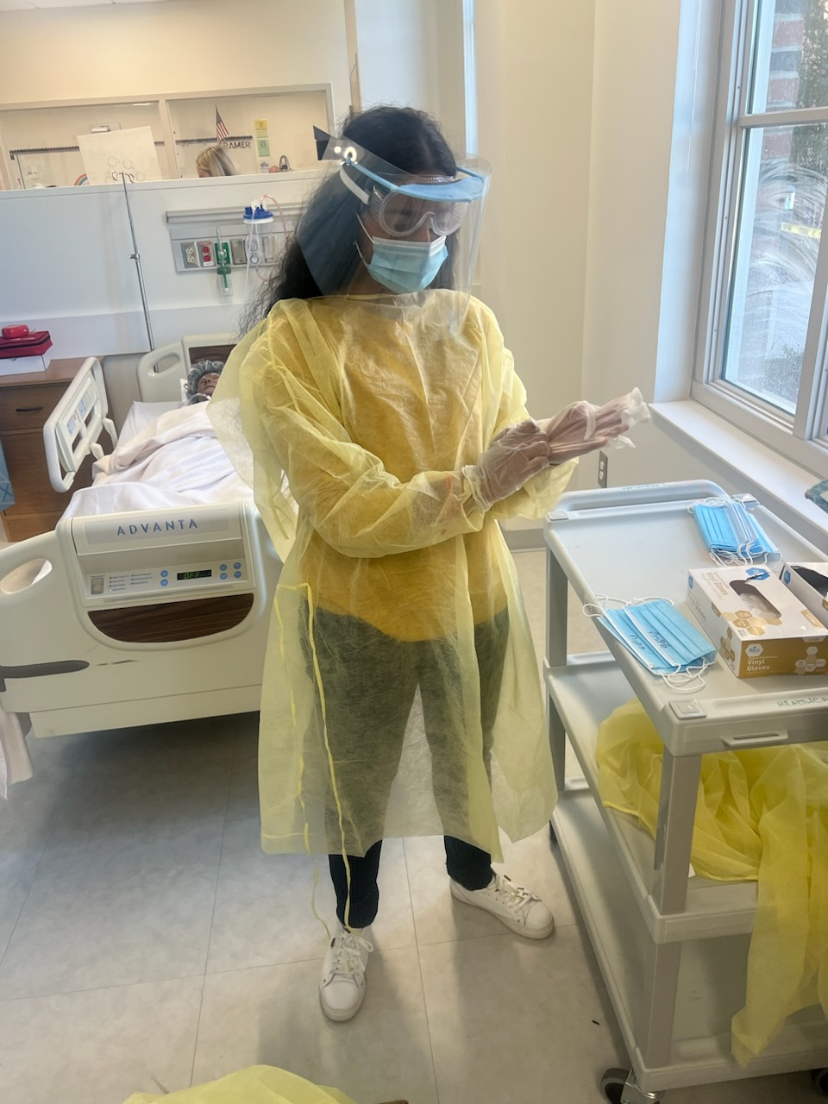
GT Block
Students are engaging in ongoing cross-curricular projects.
Data from second year teachers indicate that after GT Block students enter their pathway specific courses with advanced knowledge and skills in each pathway.
They are learning not only fundamental skills for pathways but are learning the difficult skills of teamwork, problem-solving, and persistence.

Slide 13
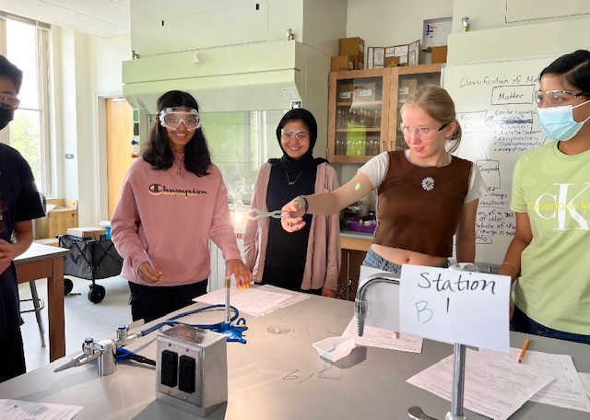
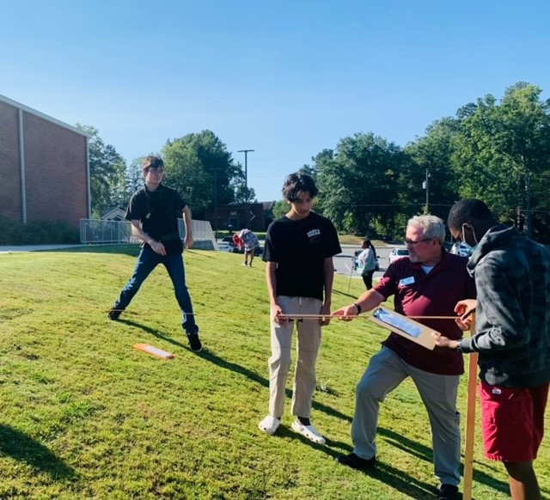
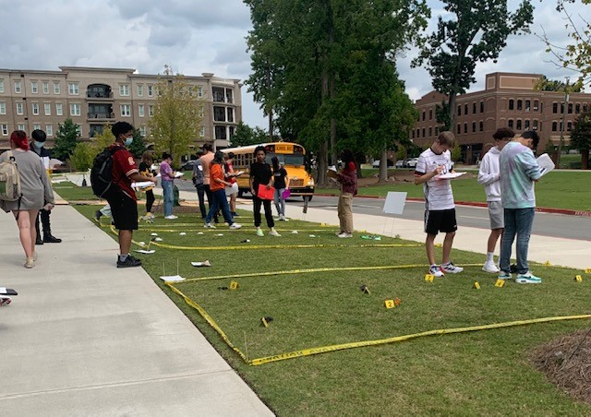
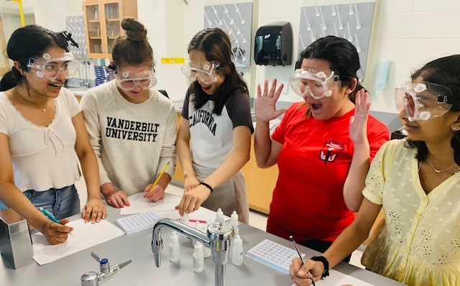
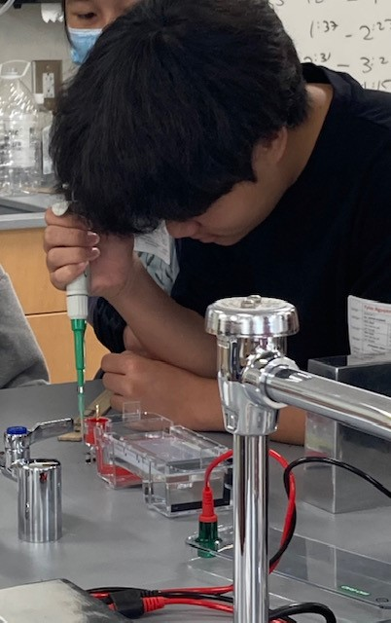
Science
Earth Systems
Focusing on preparing students for relevant experiences utilizing labs and a deep knowledge base about different phenomenon in the world.
Our AP and Honors programs are preparing students for college level courses in both laboratory and lecture-based assessments.
Chemistry
Forensics
Biology
Super-Chemistry

Slide 14
Construction
Currently scheduled to finish in December.
On schedule as of today.

Slide 15
Safety and Security
Student protection while retaining an open culture.
Police presence
Controlled access
Door monitoring

Slide 16
Balancing Expectations

Slide 17
Rigor and Support
Student and parent surveys at the 9-week mark
Evaluating support for struggling students

Slide 18
Success
Continue building on success

