Slide 1
Q3 Community Coffee Chat
Hosted by Innovation Academy PTSO, Inc.

Slide 2
Founding Officers
Spring in Review ~ Next Generation of Parent Leaders to be Identified
Q3 General Membership Meeting March 1st @ 7 pm Virtual
Nominating Committee for SY2023/SY2023 Exec Board
Only 3 of 9 Exec Board Members may return to current role
20 Advisory Board/Committee Chair roles
Anyone interested may email president@iaptso.org to meet/chat with Carissa and/or I
Executive Board and Advisory Board

Slide 3
Cultivate ~ Career Fair
Sign Up:
https://form.jotform.com/230298178183160
Friday, February 24th
Calling all Business Partners & Parent Volunteers
Interviews
Resume Feedback
Pathway Panel Discussions
Expo
Choice Board Sessions

Slide 4
Teacher Grants
Awarded Year to Date $20k!!!

Slide 5
Teacher Grants
Rose – Anne Schmidt
Thank You to our Star Teacher Grants Committee Chair!
Thank you to our members for making this a reality!
Professional Development
Academic
Ian Custar ~ NCTE Conference
LeAnn Vaughn ~ NSTA Conference
Bob Kuhn ~ Mini PCR Thermocycler
Ginny Berkemeier ~ Genetic Modification Fruit Flies\
Laura Taylor ~ Budget Challenge Program Subscription for Financial Literacy Instruction
Bob Kuhn ~ Gel electrophoresis for biotech lab
Patrick Wiegand ~ Soil & Water Erosion Stream Tables
Ginny Berkemeier ~ Viral Diagnostic Lab: Beating the Next Pandemic
Sean Fallon ~ EMT Training
Kenny Marbry ~ Science Lab Vacuum Filtration Pumps
Ian Custar ~ Book: "Justice: What's the Right Thing to Do?" by Michael Sandel (Joint ELA/SS)
Pam Whitlock & Ginny Berkemeier ~ Sphero BOLT Power Pack
Steve Jones ~ Telescope & Accessories for Astrology
Administration
Admin ~ School Wide High Quality Drone
Counselling ~ Portable Monitors & Stands to support students

Slide 6
Large image
Puss in Boots ~ The Last Wish
Thursday March 2nd after school
Student Choice Movie Event

Slide 7
Phoenix Fest
Save the Date ~ Thursday, April 13th
4:15 pm to 8:00 pm

Slide 8
Thank You
Lorri Werner
770.363.9190
president@iaptso.org
IA PTSO

Slide 9
Spring Testing: Overview
Dates | Exam
7-Mar | ACT
11-13 April | End of Pathways Assessments
Week of 24-April | End of Course Assessments
1-12 May | AP Exams

Slide 10
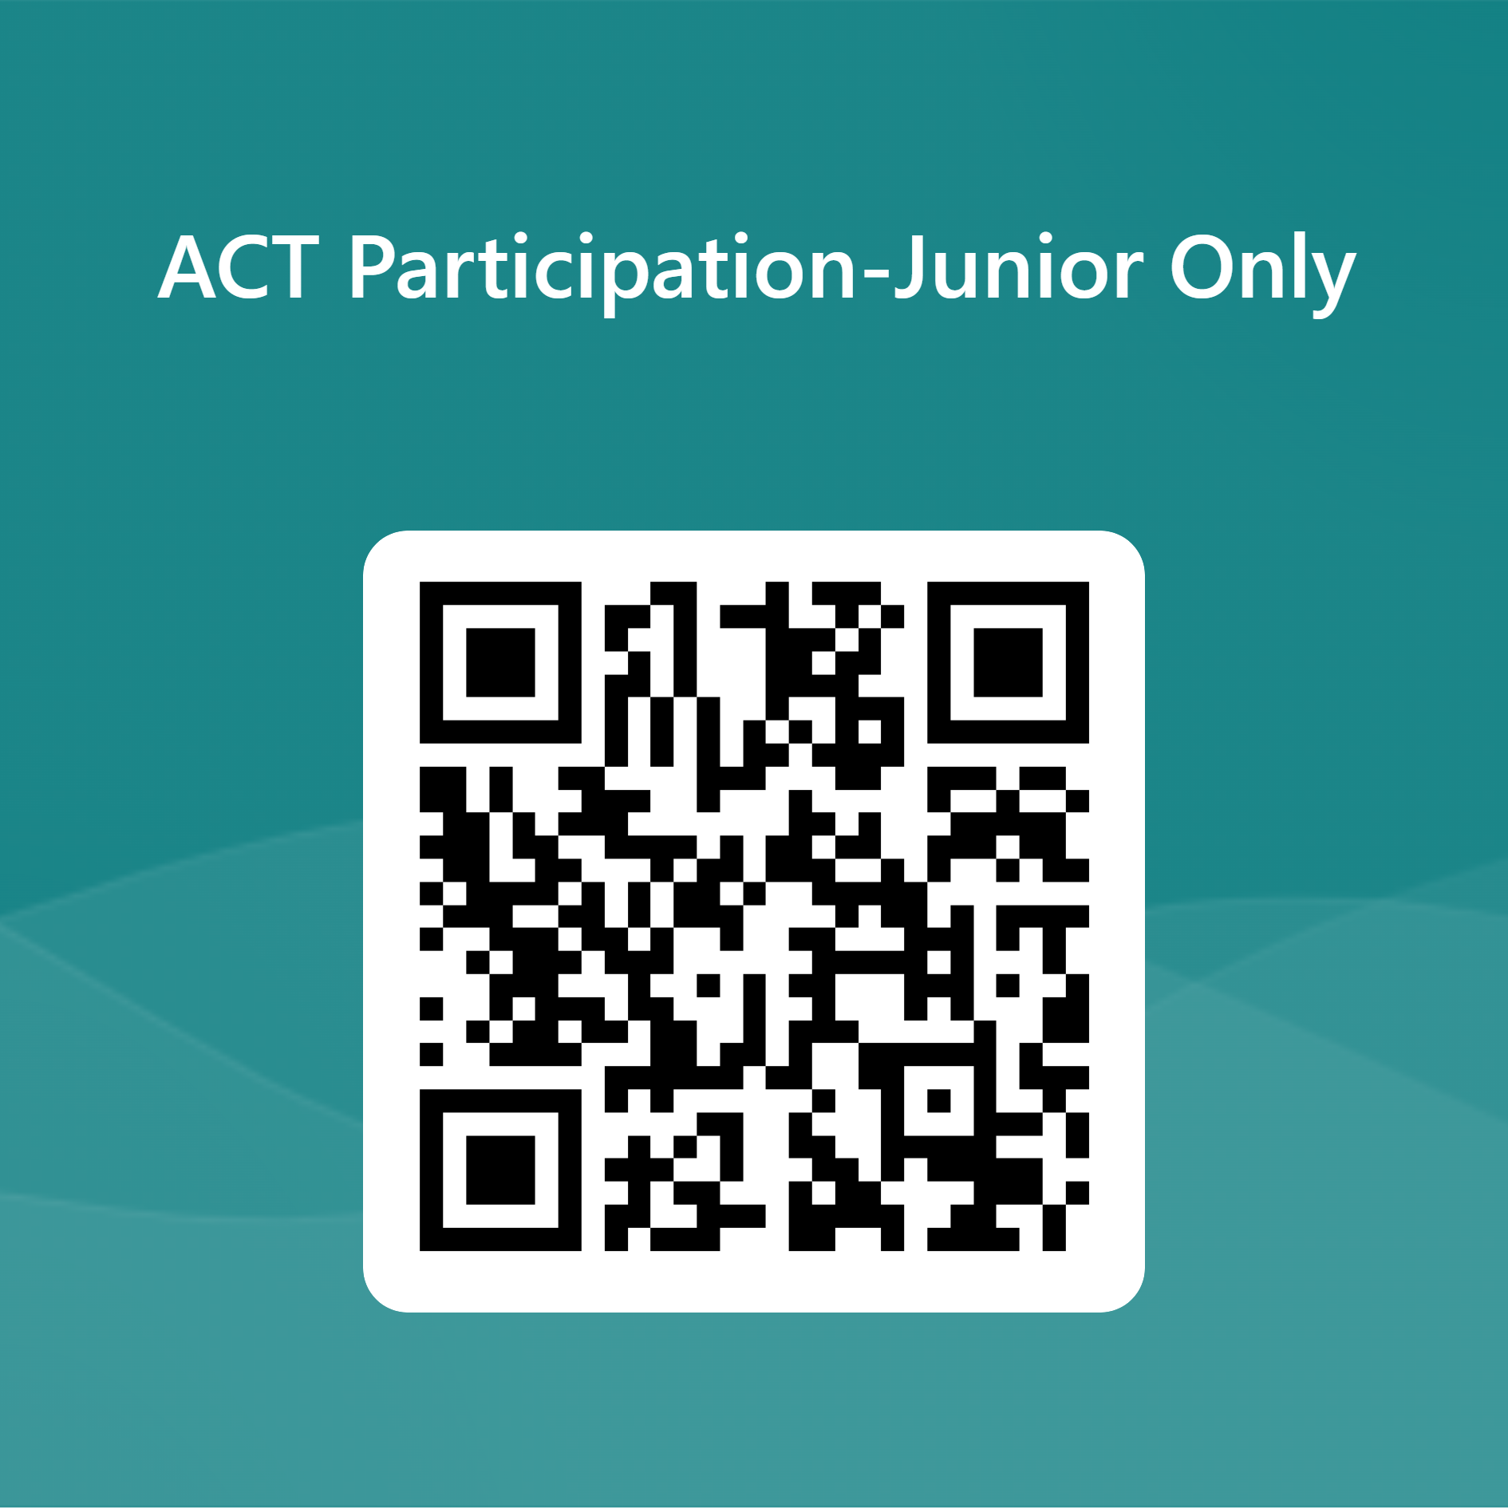
Spring Testing: ACT Exam
Like the SAT, the ACT demonstrates college readiness. One is not easier than the other. Both are widely accepted by colleges and serve as an indicator of a student's critical thinking and analytical skills.
ACT is for Juniors only on 03/07 8:40am-12:15pm.
No fee required.
Exam is optional, but must indicate participation with QR code (Beacon, Teams)
Regular schedule for Freshmen, Sophomores, and Juniors who won't test.
Students must have an FCS device to take the ACT.
No make-up exam.

Slide 11
Spring Testing: CTAE End of Pathway Exams
DATE | TIME | COURSE | EXAM | NOTES
4/11/23 | 9:00 am | Surgical Technology | National Health Assessment (Precision Exams) | 90 minutes
4/11/23 | 12:00 PM | Engineering 3 | Engineering Technology (SkillsUSA Workforce Ready) | 60 minutes
4/12/23 | 9:00 AM | APCS A | Computer Science (NOCTI) | 3 hours
4/12/23 | 1:00 PM | EMR | Therapeutic Services – EMR (NREMT) | 2 hours
4/13/23 | 9:00 AM | Game Design | Unity exam | 90 minutes
4/13/23 | 1:00 PM | Patient Care Fundamentals | Patient Care CPCT (NHA) | 2 hours
Students should bring their school issued laptop fully charged.

Slide 12
Spring Testing: CTAE End of Pathway Exams
End of Pathway exam score does NOT affect student's grade in Infinite Campus or on their transcript.
A "Pathway Completer" is a student who successfully passes all three courses in their specific pathway. Pathway completers will receive:
Pathway completion certificate
Pathway completion diploma seal
Students who also pass the End of Pathway exam will receive an industry certification from that testing agency. These students will receive:
Pathway completion certificate
Pathway completion diploma seal
Industry certificate
Red CTAE graduation cord

Slide 13
Spring Testing: End Of Course Exams
EOCs are part of the Georgia Milestones Assessment System and provide students with critical information about their own achievement and their readiness for their next level of learning. Only courses with an EOC: American Lit, US History, Biology, Algebra 1.
EOCs will be administered in the morning, and they will be regular school days.
EOCs will take place the week of April 24th, the official schedule has not been published yet:
Juniors will take American Literature (3 sections) and US History.
Freshmen will take Biology and Algebra 1.
EOCs are 20% of the students' course grade and they are not optional.
Students must have an FCS device to take the EOC.

Slide 14
Spring Testing: AP Exams
All students taking an AP course will take the AP exam for that course.
2-week testing calendar: May 1–5 and May 8–12.
No make-up date. Late testing is not for makeup exams
FCS pays for exams, students must be registered in AP Classroom through their course
$40 penalty fee per cancelation or unused exam
Mock exam opportunities for some exams in April

Slide 15
Results from SGC parent survey and focus groups
15 February 2023

Slide 16
Survey/Focus group results: improved communications from administration
SURVEY COMMENTS
FOCUS GROUP COMMENTS
ACTIONS BEING TAKEN
Insufficient communications from pathway leadership
Confusion about changes to normal schedule / Flex Fridays
Lots of different places to look for information
Want ‘single source of truth’ for the school calendar, school events, Flex Fridays and pathway events
Confused about how to access Infinite Campus
Students overwhelmed by volume of Teams messages
Funding part-time communications leader in 2023-24 budget to coordinate efforts
Investigating existing website calendar vs. a separate option to provide single source of truth for calendar, including pathway events

Slide 17
Survey/Focus group results: ia’s level of rigor
SURVEY COMMENTS
FOCUS GROUP COMMENTS
ACTIONS BEING TAKEN
Classes are too difficult, students don’t have time for extracurriculars
Seven advanced classes is too much
Fix overlapping test dates
IA should be a rigorous school—that’s why we came here
Students putting a lot of pressure on themselves
“Rigor doesn’t equal more work, but better and more substantive work.”
Hiring leader to support peer-to-peer mentorship
Increasing 2023-24 budget funding for both an additional counselor and to fund a part-time college advisor

Slide 18
Survey/ Focus group results: virtual classes
SURVEY COMMENTS
FOCUS GROUP COMMENTS
ACTIONS BEING TAKEN
High level of dissatisfaction with virtual language instruction and virtual classes in general
Desire for on-site engagement with students for languages
Parents perceive that students don’t consistently take the classes seriously and don’t have to do their work
Some parents looking for a more supervised space for students
Funding additional virtual class support as part of 2023-24 budget
Language tables during lunches for students to speak with native-speakers (parent volunteers?)
Exchange/Travel Abroad program to provide immersive experiences

Slide 19
Survey/Focus group results: expectations for student independence
SURVEY COMMENTS
FOCUS GROUP COMMENTS
ACTIONS BEING TAKEN
Treat the students as high-school students, they aren’t in college
Less opportunity for free time
Freshman education on time management
Too much flexibility on Fridays
Students need to earn their freedom and get it more gradually vs. an abrupt shift from middle school
Need significantly improved responsiveness from counselors to parent phone calls
Launching IA Bridge Program (2-week session to acclimate students to IA)
Shifting guidance to teachers for a ‘gradual release’ of accountability to students (full independence by end of junior year)
Building out communication calendar for college and career to support to allow counselors more focus on counseling and scheduling

Slide 20
Budgetary Priorities
We are purchasing an additional counselor position above our allocation.
We are purchasing a half-time College and Career Center support staff.
Allocating personnel resources to support internal and external communications

